Slide 1
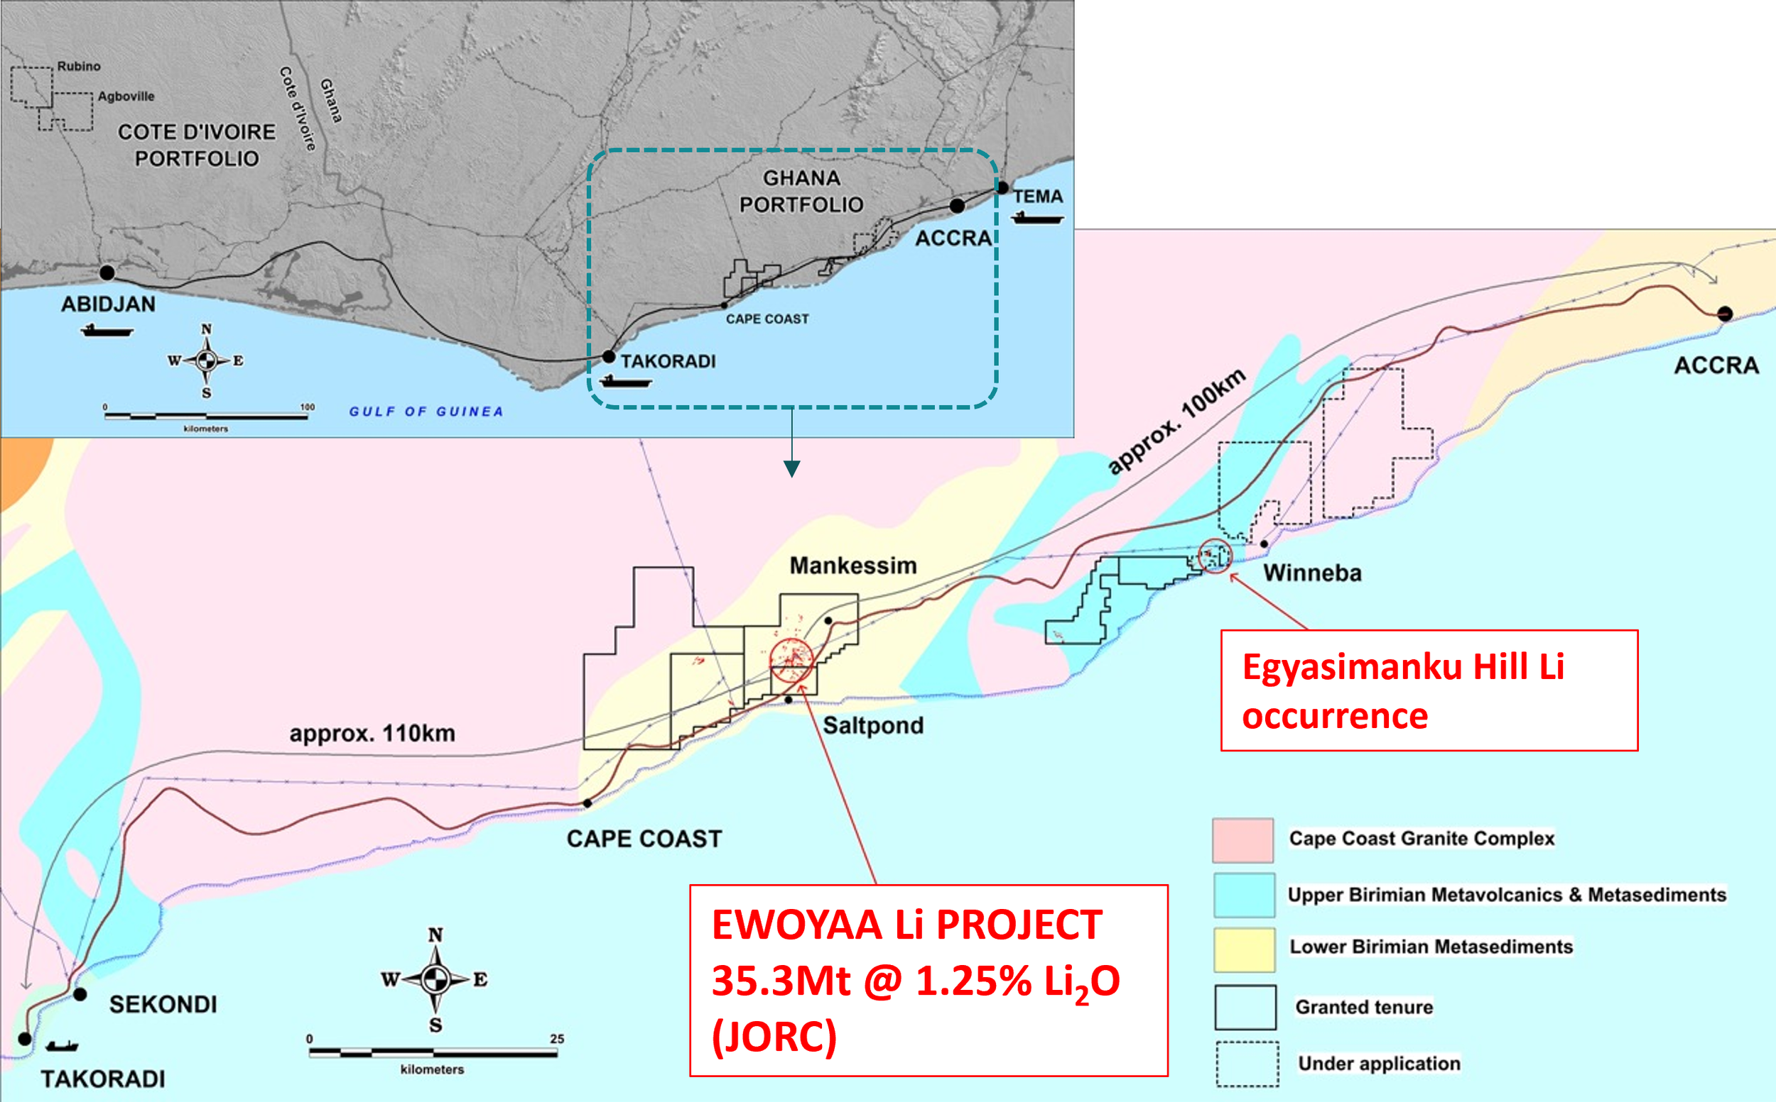
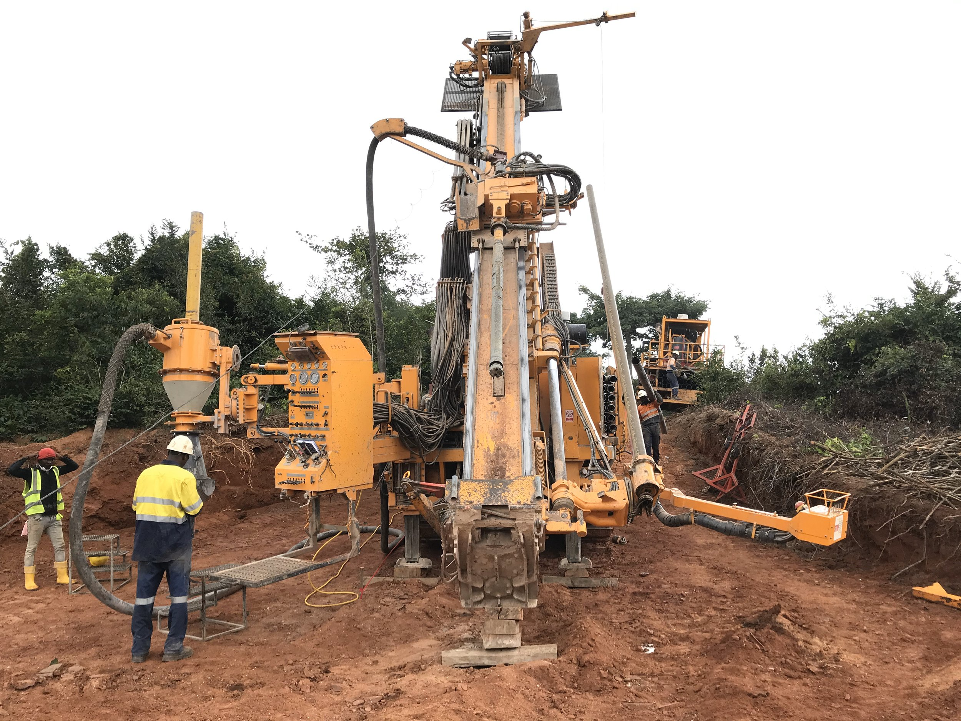
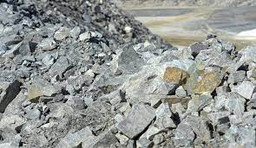
PRESENTATION AT GHANA INSTITUTION OF ENGINEERING
GHANA’S FIRST LITHIUM CONTRACT, TERMS, BENEFITS AND WAY FORWARD
ENGINEERS CENTRE, 13 CONTINENTAL ROAD
14 DECEMBER 2023

Slide 2
Outline of Presentation
Introduction.
Background on the Project.
Policy Framework for the Negotiations.
The Lithium Value Chain.
Terms and Benefits.
Way Forward.

Slide 3
GREEN OR CRITICAL MINERALS FOR GREEN ENERGY TECHNOLOGIES
Electric Vehicles | Renewable Energy (solar and wind) | Energy Storage | Electronics
Lithium, Nickel Manganese, Cobalt Graphite and Rare earth elements | Nickel, Manganese, Chromium, Cobalt, Silicon, Gallium, Germanium and Rare earth elements | Nickel, Cobalt. Alumina, Graphite Lithium, Manganese and Vanadium | Antimony, Beryllium, Germanium Lithium, Niobium, Indium Rare earth elements, Alumina Platinum group elements Scandium, Silicon, Tantalum and Tungsten

Slide 4
Introduction
Barari DV Ghana Limited (“Barari”) was first granted a reconnaissance licence in Aug., 2012 & converted to prospecting licence in March 2018 for 3 years & renewed for 3 years in July 2021.
Barari is the subsidiary of Atlantic Lithium Limited, an Australian company listed in Australai & London.
The mining lease covers 42.63 Km² in & around Ewoyaa in Mfantseman Municipality of the Central Region.
Barari submitted a feasibility study to Mincom & applied for a mining lease & granted for 15 years in Oct., 2023.

Slide 5
Intro (cont’d)
Life of mine of twelve (12) years.
Average production of about 350,000 tonnes of concentrate at 5.5-6% lithium oxide:
Construction & Development Cost of US$185 million
Construction & Development will take at least 14 months.
Average Sale Price of lithium Concentrate (over Life of Mine): US$ 1,410 per tonne.
Other minerals- Feldspar, Kaolin, quartz (silica).

Slide 6
Policy Framework for the Negotiations
What the critiques are saying?
Look at emerging practice in South America
Adopt Competitive Bidding (CB), Joint Ventures or Service Contracts:
Transparency;
Potential for Rent maximization;
Secure greater value for the State.
The Republic of Ghana should set up a company to develop the entire value chain from mining raw Lithium to manufacture of batteries and other products in Ghana.

Slide 7
Policy Framework for the Negotiations
Hon Minister on 13 July 2023, presented to Parliament a policy statement on the development of our country’s green minerals.
The statement highlighted the importance of these green minerals to our socio-economic development.
The Minister further stressed the adoption of a governance, legislative & regulatory framework that will position Ghana as a key player in the green transition.
The Minister then submitted a memo to Cabinet to request for policy approval for the regulation, exploitation & management of green minerals.

Slide 8
Policy Framework (cont’d)
The following were considered as options to address the policy gaps:
incorporate into the 2014 Mining Policy some specific provisions for the management of the exploitation & utilisation of green minerals;
prepare some general guidelines to support engagement & negotiations with investors & other players who venture into the green minerals industry; a
prepare a completely separate policy & legal regime for the green minerals & build it to the status of GIADEC and GIISDEC.

Slide 9
Policy Framework (cont’d)
Cabinet approved in July 2023 the first option which requires a review of the current Mining Policy to incorporate provisions on green minerals.
The justification for the choice of this option include:
Lack of geological information/data unlike Bauxite where the deposits/mineral resources exist including a mine in operation (Ghana Bauxite Co., Ltd);
The Ewoyaa deposit is relatively very small compared to the deposits in Zimbabwe, Mali, DRC & in the Lithium Triangle (Chile, Argentina & Bolivia host about seventy (70) percent of the known lithium reserves in the world.

Slide 10
Policy Framework (cont’d)
Zimbabwe-biggest reserves in Africa & 6 in the world.
Zimbabwe had 160 applications from China and 5 from USA in first half of 2023-Zimbabwe Investment Development Agency).
No known deposits or discoveries apart from Ewoyaa.
Need to attract high-risk exploration (5% chance of success).
Competing with others with better geology & higher grades-Mali (Goulamina, Bougouni), DRC (Manono).
It is the reason that the creation of a separate entity to manage lithium (like GIADEC was not recommended).

Slide 11
Policy Framework (cont’d)
CB is in the law- Minerals & Mining (Licensing) Regulations, 2012 (Regs., 257 & 258 of L.I. 2176). Reg., 258(1) of L.I. 2176:
“The grant of a mineral right may be made through tender where:
the Commission determines that there exists sufficient mineral information in respect of the area concerned;
the Republic has carried out prior mineral exploration in respect of the area concerned; or
an area becomes available through surrender, revocation or termination and two or more applications are recorded in the Priority Register within the seven days of the area becoming vacant.”

Slide 12
Policy Framework (cont’d)
In addition to the first option, Cabinet approved further policy proposals including:
Review Act 703 to provide, in addition to the ten (10) free carried interest for the State, for additional mandatory Ghanaian participation similar to the requirements in Act 976 & Act 988 to ensure a minimum of thirty (30) percent Ghanaian participation.
Set a royalty rate at a minimum of seven (7) percent;
Provide some benefits to incentivise investors to move into higher levels of the value addition chain;

Slide 13
Policy Framework (cont’d)
Minerals Income Investment Fund (MIIF) should manage the State’s interest in line with its legislation and facilitate other Ghanaian participation.
Provide for mandatory listing on the GSE.
Review Act 703 to empower the Minister to prohibit the export of green minerals in their natural state to encourage value addition & ensure at least the retention of the value chain in-country.
It is within the above policy measures that Government negotiated the terms and conditions of the Barari lease.

Slide 14
The Lithium-ion Battery Value Chain
The lithium-ion battery value chain can be divided into five main stages, namely:
Mine/Concentrate (US$ 1655- Dec. 6, 2023,);
(US$ 3775-July. 6, 2023);
Refining (US$17113.25-Dec. 6, 2023);
(US$ 42,650.28-July.6, 2023);
Making battery materials;
Manufacturing the cells; and
Assembling the cells into battery packs.

Slide 15
The Lithium-ion Battery Value Chain
According to the IEA & also the article “Lithium Outlook”, published in the Mining Journal of Dec, 2022:
China accounts for 13% behind Australia & Chile, which account for 52% & 25% of world production respectively.
China accounts for only 8% reserves, Chile holds 42%.
Australia holds 26%, Argentina with 10%.
China dominates midstream & downstream of the entire value lithium value chain.
China accounts for 44% of all lithium carbonate and hydroxide production, 78% of cathode production and 70% of lithium-ion battery cell production.

Slide 16
Terms and Benefits
Sector Fiscal Regime
Royalty Rate: - 10% on lithium and all associated minerals(5% for mining sector)-Clause 20(a)
Australia-5%, Chile 8-26%, Mali-6%, Zimbabwe-5%.
Corporate Income Tax Rate: - 35%
Australia-30, Mali-30%, Zimbabwe-25%
Freed Carried Interest: - 13% (10% for rest of mining sector)-Clause 19(b);
Mali-10%, Zimbabwe has no free carried interest

Slide 17
Terms and Benefits
Sector Fiscal Regime
GET Fund (2.5%)-Clause 19(a);
NHIL (2.5%)-Clause 19(a);
Growth and Sustainability Levy (1.0%)-Clause 19(a);
Setting up a Community Development Agreement Fund (1.0% of Revenue)-Schedule 2;

Slide 18
Value Addition & use of Other Minerals
Four (4) months from the grant of Lease Company shall submit to the Commission a full study on the:
use of Feldspar- (1(a) of Schedule 2);
Establishment of a Chemical Plant (downstream conversion) to refine concentrate-(1(b) of Schedule 2);
Where the company cannot establish a chemical plant, the company shall supply the concentrate to any chemical plant by another party’ (1(d) of Schedule 2)
Company has MOU signed with UMAT for feldspar assess the production, market size, local use) etc;

Slide 19
Value Addition & use of Other Minerals (cont’d)
Use of the by-products can only be used in Ghana (Feldspar, Kaolin & Quartz)- (i(e) of Schedule 2)
Used for ceramics, glass, cosmetics, electronics & other industrial uses.
Its critical to note that construction & development shall take not less than 14 months so various studies shall be ready before construction commences.
In fact, UMAT has already submitted the scoping study & full feasibility report next week.

Slide 20
Additional Ghanaian Participation
Minerals Income Investment Fund (MIIF) Strategic Investment
Total Investment of US$ 32.9 million
6% Ownership, through US$27.9 million investment into the Ghanaian project company (Barari Development Ghana Ltd); and
3.06% Ownership, through US$5 million investment into the Australian and UK-listed entity (Atlantic Lithium Limited).
Mandatory Listing on the Ghana Stock Exchange
Discussions with GSE and SEC progressing very well.

Slide 21
Way Forward
Ratification of the Lease-(Article 268 of Constitution of Ghana, Section 5(4)of Act 703, 1(e) of the Mining Lease)
Secure the following Permits:
Environmental Permit (EPA);
Operating Permit (Minerals Commission);
Construction Permit (Minerals Commission).
Submit various studies for the development of the value chain not later than February 2024.
Complete Community Development Agreement with Communities to be impacted after obtaining all permits.

Slide 22
THANK YOU FOR YOUR ATTENTION

