Slide 1

GhIE Evening Session
Application of Computer Modelling for Flood Resilience Planning in the Odaw Basin: The GARID Project Case Study
Ing Kodwo Beedu Keelson
Date: September 14, 2023

Slide 2
CONTENT
Background and Context
Flood Model Development
Flood Hazard Assessment
Evaluation of Flood Mitigation Measures
Summary of Key Findings
Limitations
Conclusions and Recommendations

Slide 3

Background and Context

Slide 4
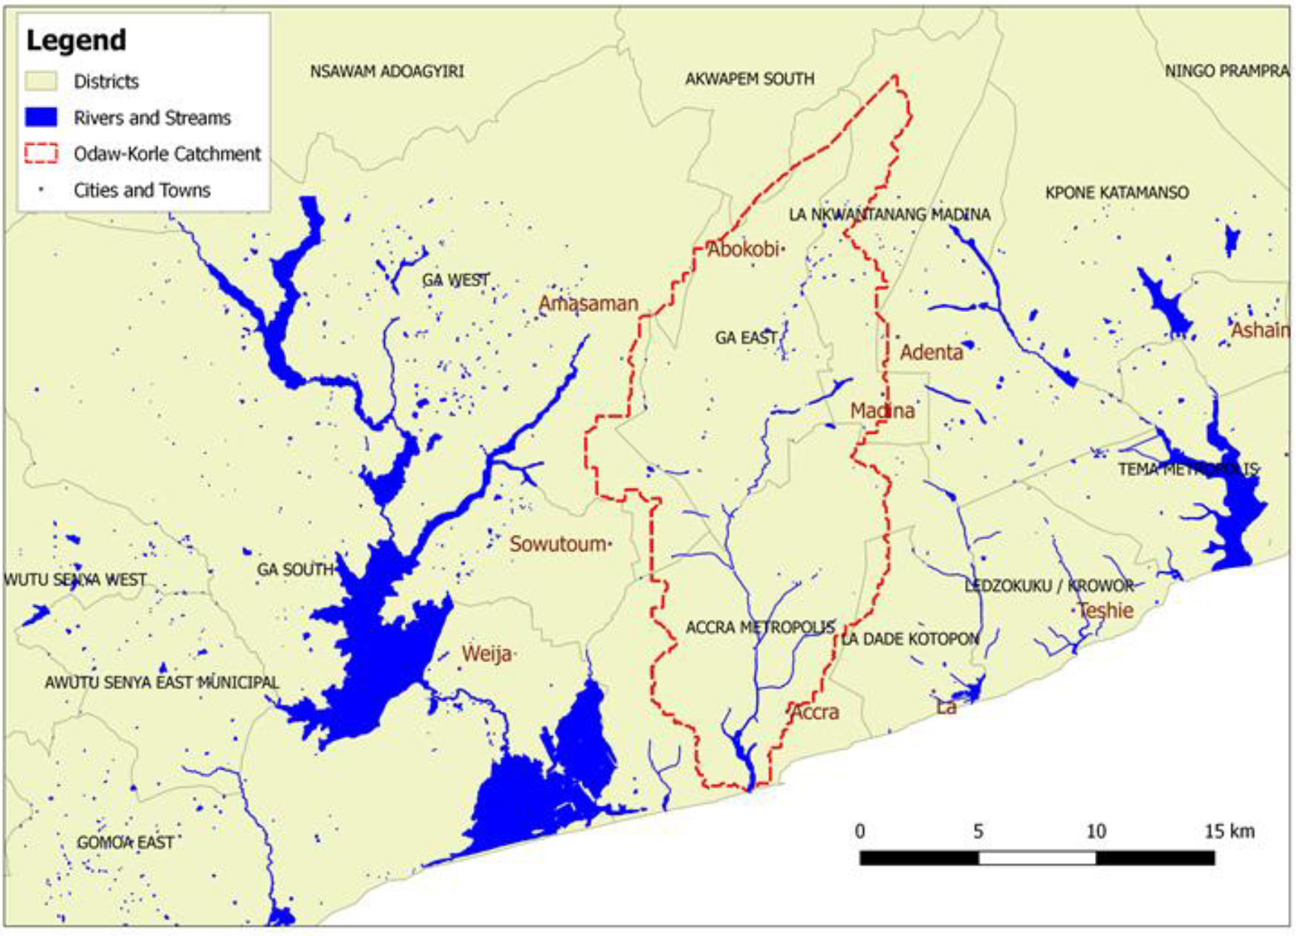
Background and Context
Study Area
Odaw Basin is one of the major drainage catchments in the Greater Accra Metropolitan Area (GAMA).
Covers an area of about 300 km² and extends over 17 Metropolitan and municipal areas
The catchment lies within the dry equatorial climatic zone of Ghana which exhibits seasonality in rainfall distribution.
Major rainfall period from March to July
Minor rainfall period from September to November.

Slide 5
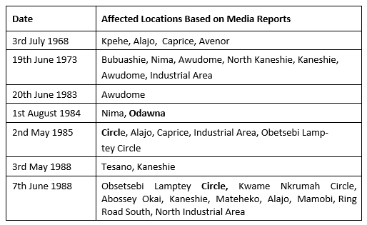
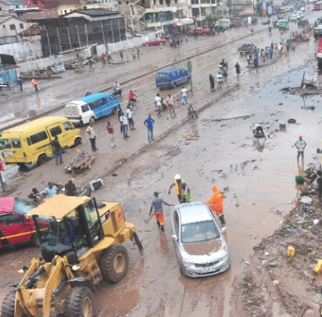
Background and Context
Major Flooding Events in Odaw Basin (1960 - 1990)
Odawna/Kwame Nkrumah Circle/Avenor enclave
Obestsebi Lamptey Circle /South Kaneshie enclave

Slide 6
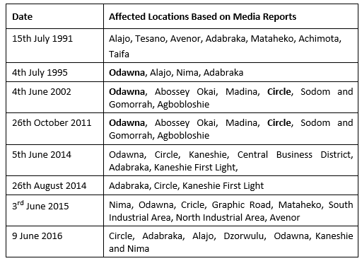
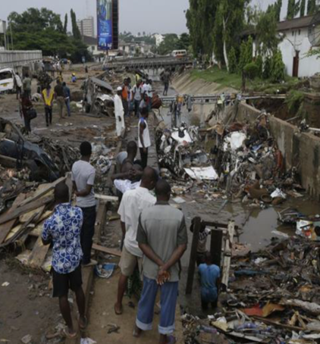
Background and Context
Major Flooding Events in Odaw Basin (1990 - 2020)
3rd June 2015 event had a precipitation amount of 131 mm in six hours, which corresponds to a return period of 11 years (HKV, 2018).

Slide 7
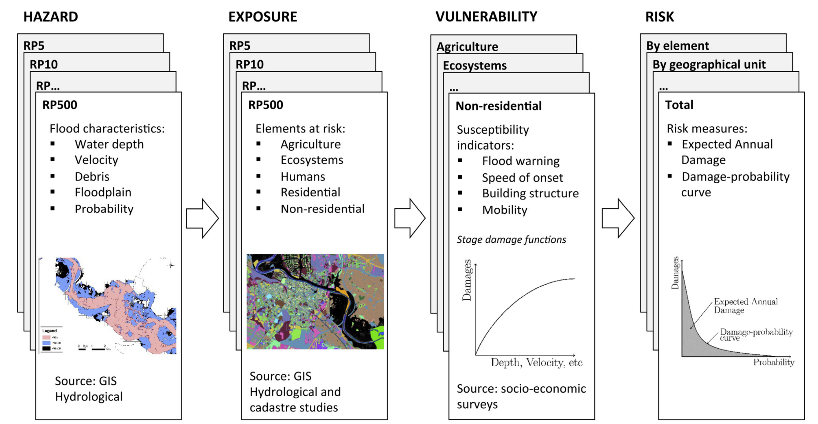
Background and Context
Flood Risk Assessment and Flood Resilience
Flood Resilience
Flood resilience is the capability to anticipate, prepare, respond to and recover from flood hazards to minimize damage to social well-being, health, the economy and the environment.
Virginia DCR
(www.dcr.virginia.gov)
Step Diagram for Flood Risk Assessment (Erdlenbruch et al., 2008)

Slide 8
Background and Context
Flood Modelling of Drainage Basins in the Greater Accra Metropolitan Area (GAMA)
1998: Korle Lagoon Ecological Restoration Project
2019: GAMA Integrated Urban Environmental Sanitation Master Plan
1991: Urban II Project (Accra Drainage Master Plan)
2017: Greater Accra Climate Risk Mitigation Strategy
2006: Tema Drainage Master Plan
2006: UESP II Project (Accra Storm Drainage Improvement Works)
1994: Korle Lagoon Ecological Restoration Project

Slide 9

1991 Accra Drainage Master Plan
Software
HYDURB model developed by Sir Mott MacDonald & Partners.
Model
Configuration
River network comprises of 84 reaches and 61 nodes covering 2.81 km of Korle Lagoon and a 7.17 km length of the Odaw River. Upstream and downstream boundaries are Achimota bridge crossing and Korle lagoon outlet respectively.
Input Data for Model Development
Daily total rainfall records (GMET)
IDF Curves (based on Dankwa, 1974)
River cross-section data from topo survey (1991)
Tidal data from Admiralty Charts
Calibration & Validation Data
Simulated inflow hydrograph (May 1986)
Nsawam Road at Alajo - Water level (May 1986)
Alajo gauging station - Discharge (May 1986)
Zeus Hotel/P&T Building –Water level (1991)

Slide 10
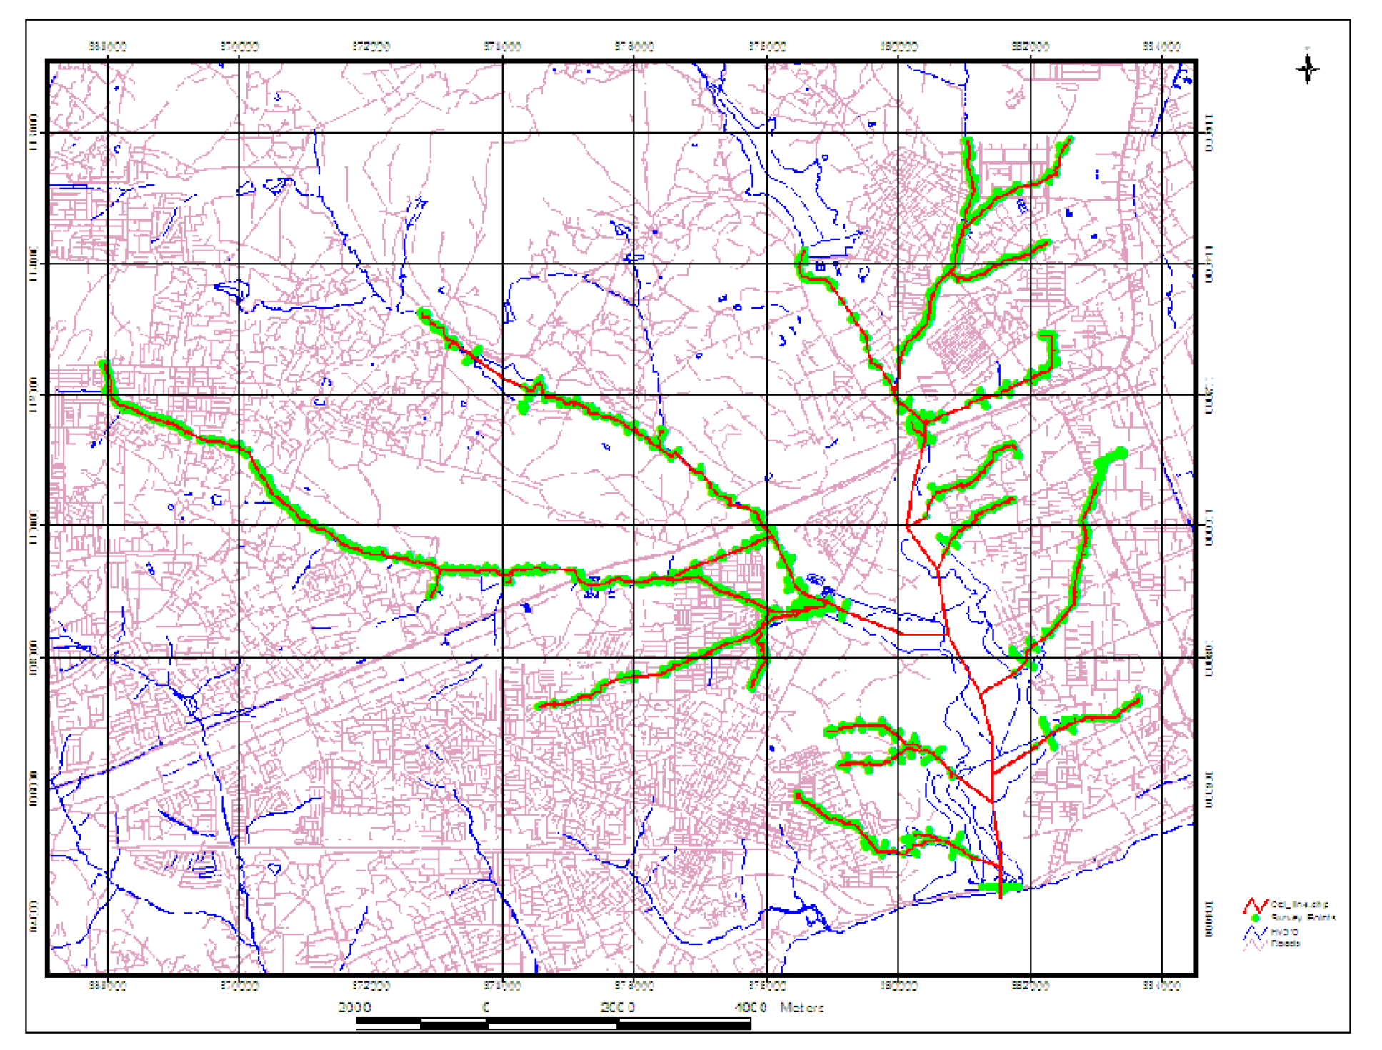
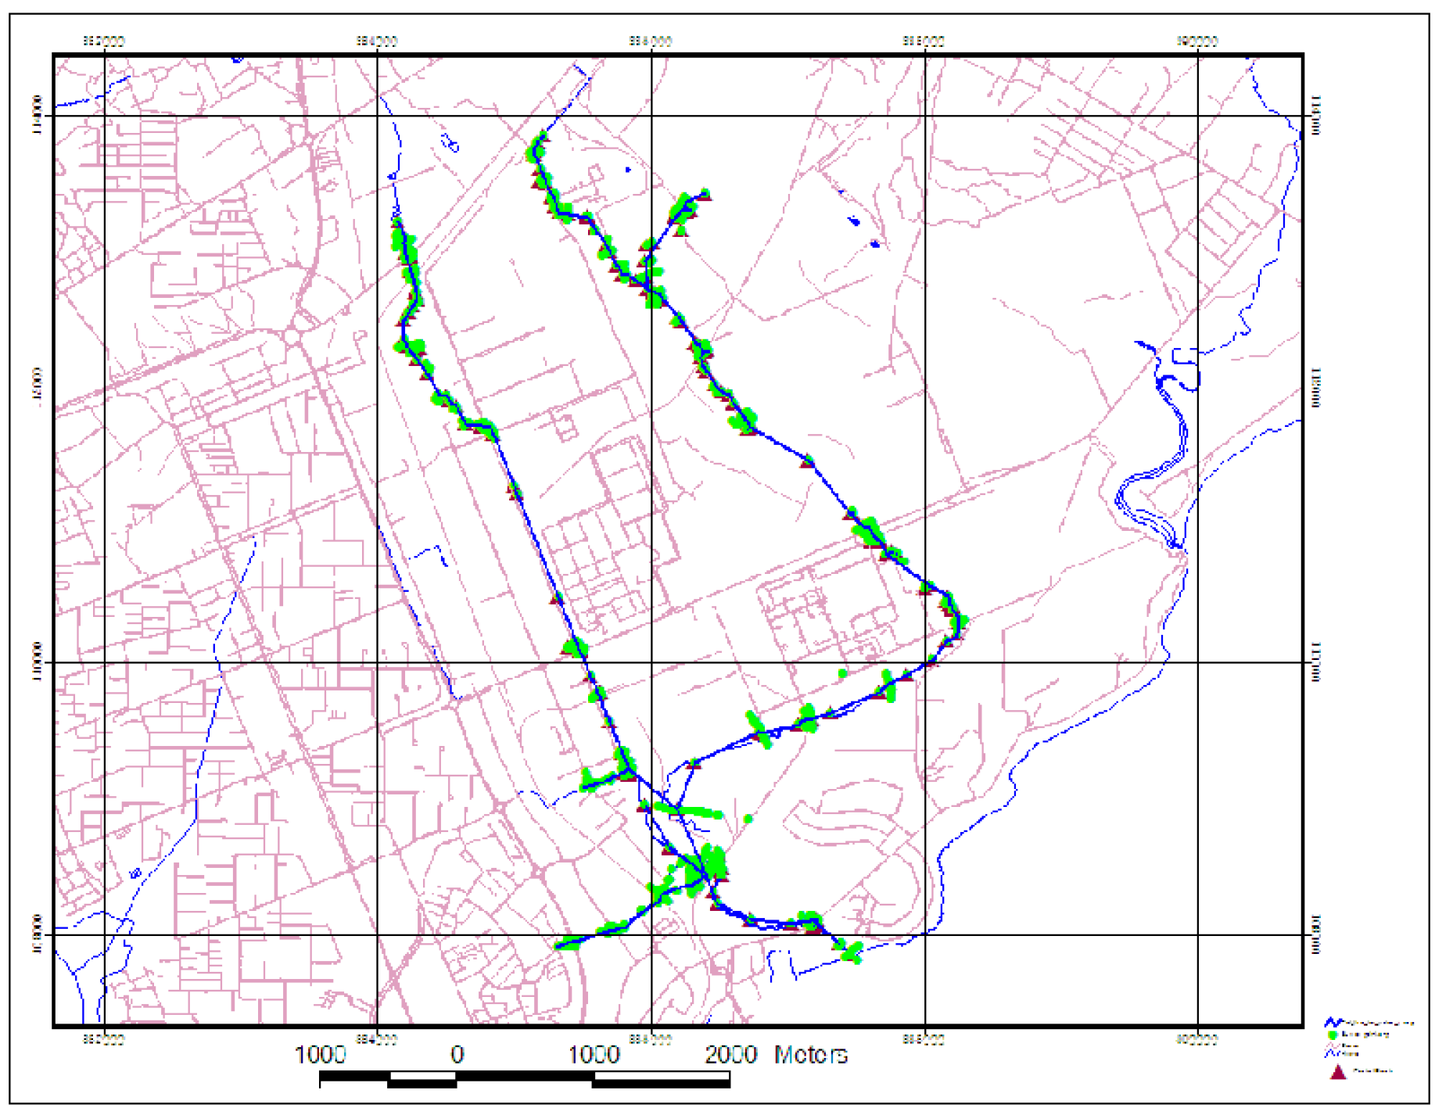
2006 Tema Drainage Master Plan
Software
XPSTORM (A computer software that has been developed from the engine of the SWMM model)
Model
Configuration
The 5 catchments in the Tema Metropolitan Area were divided into sub-basins based on the drainage network, the topography, and locations of flow control structures such as culverts.
Input Data for Model Development
Tema IDF Curves (GMET)
Daily total rainfall records (GMET)
River cross-section from topographic survey
Tide table (GPHA, 2006)
Calibration & Validation Data
It was not possible to calibrate and verify the XP-STORM models. A sensitivity test of the parameters adopted were carried out in order to determine how variations in the values of these parameters could affect computed discharge and flood levels.

Slide 11
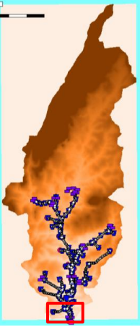
2017 Greater Accra Climate Risk Mitigation Study
Software
SOBEK (modelling software developed by Deltares).
Model
Configuration
The Odaw river and its drains are modelled as a 1D system connected to a 2D grid representing the flood plain (1D-2D approach). The rainfall runoff part is modelled with the 2D grid corrected for infiltration, interception and surface. The 2D model component provides inflow into the 1D channels at each connecting location.
Input Data for Model Development
Daily total rainfall records (GMET)
2016 IDF Curves (from GMET)
Bathymetric survey data/DEM (Caprice to sea outlet)
Calibration & Validation Data
The absence of observed flood water levels and discharges the model was calibrated in an iterative process based on qualitative flood indicators which were determined from a theoretical range.

Slide 12
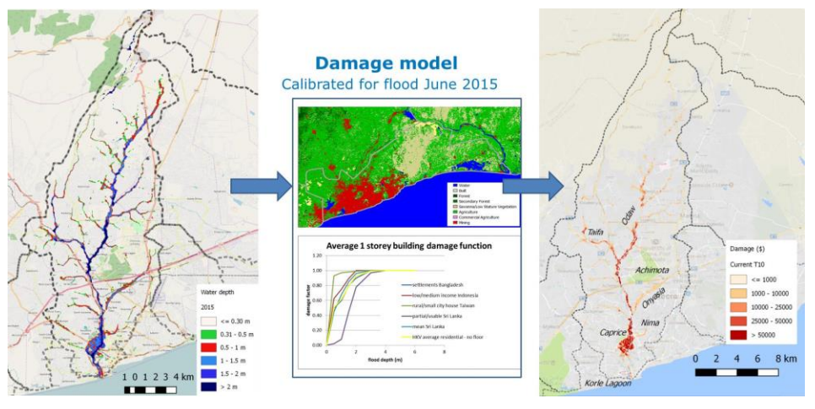
2017 Greater Accra Climate Risk Mitigation Study
Flood Hazard Map [Water Depth}
Flood Damage Map [Damage Costs $]

Slide 13
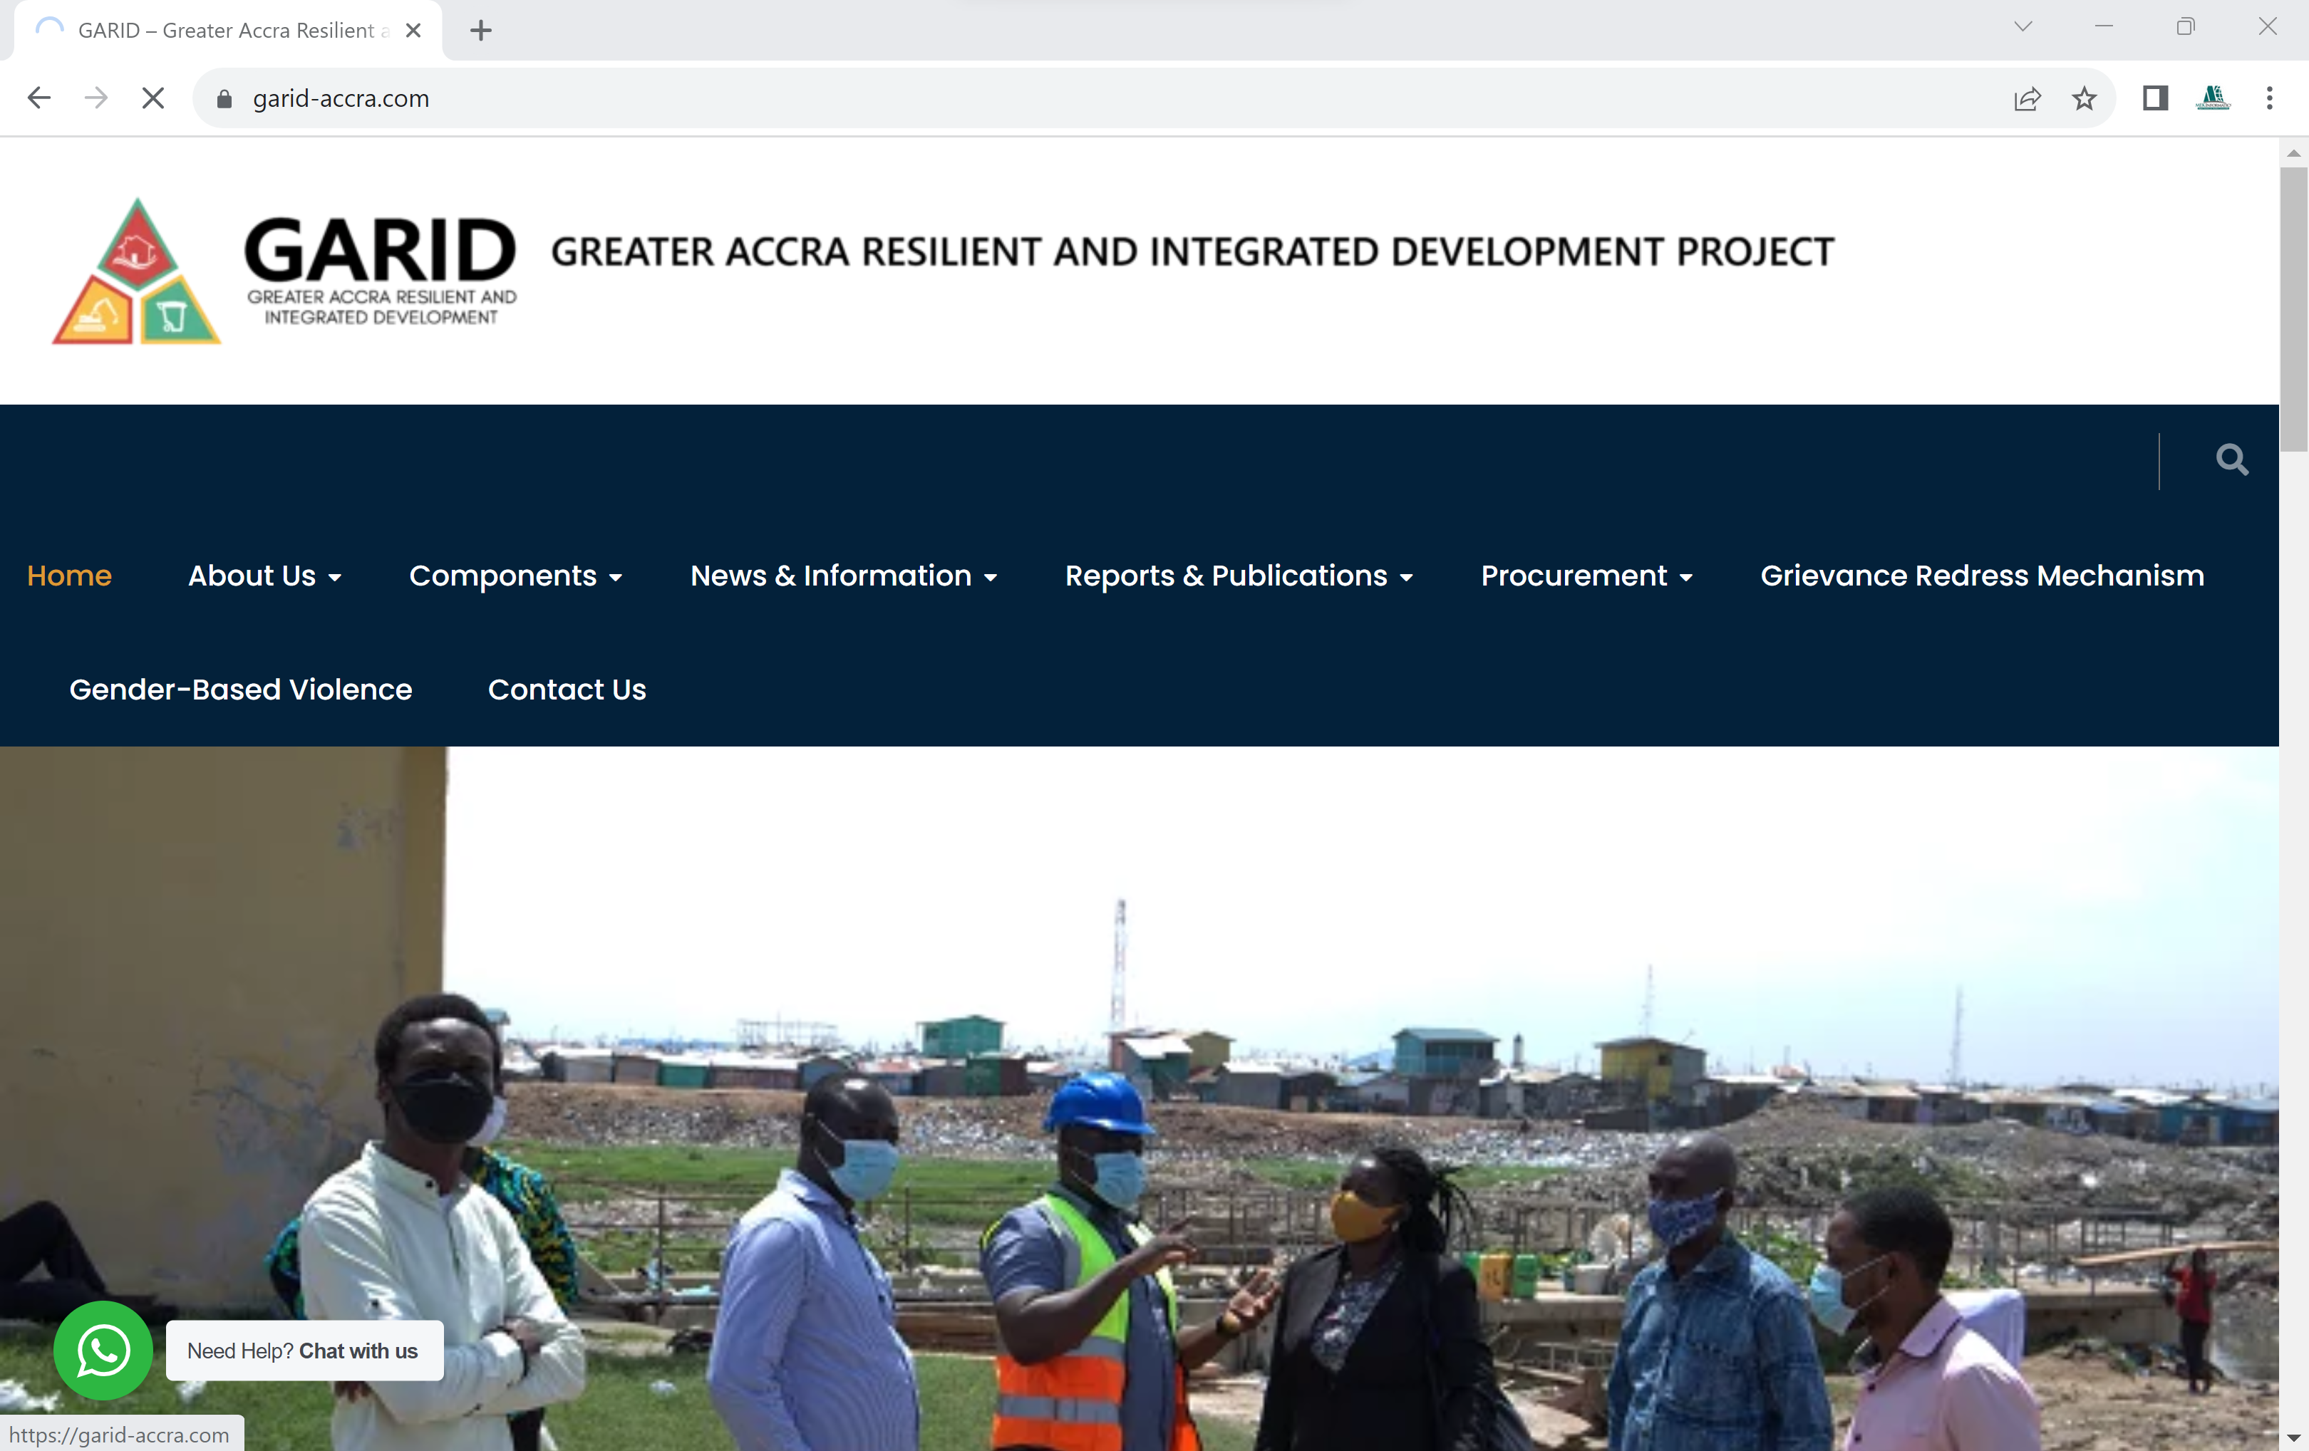
Background and Context
The GARID Project – Flood Risk Management in Odaw Basin
The Greater Accra Resilient and Integrated Development (GARID) Project is the first in a series of projects designed to build the resilience of the national capital with the initial phase covering a five-year period from 2020 to 2025.
The GARID Project seeks to improve flood risk management and solid waste management in the Odaw Basin as well as improving access to basic infrastructure and services in the targeted communities within this urban drainage catchment.
The GARID Project was preceded by the Greater Accra Climate Risk Mitigation Study
https://garid-accra.com/

Slide 14
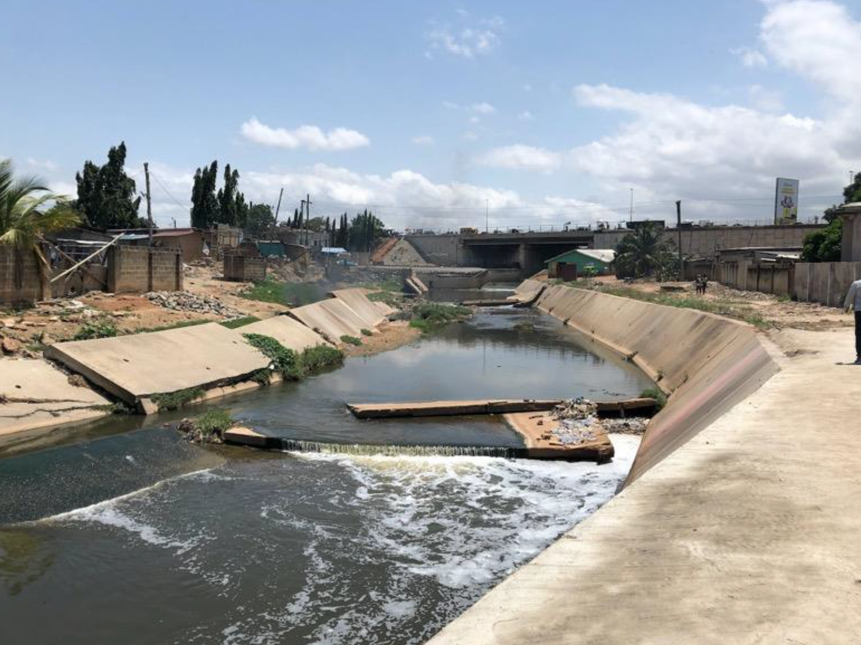
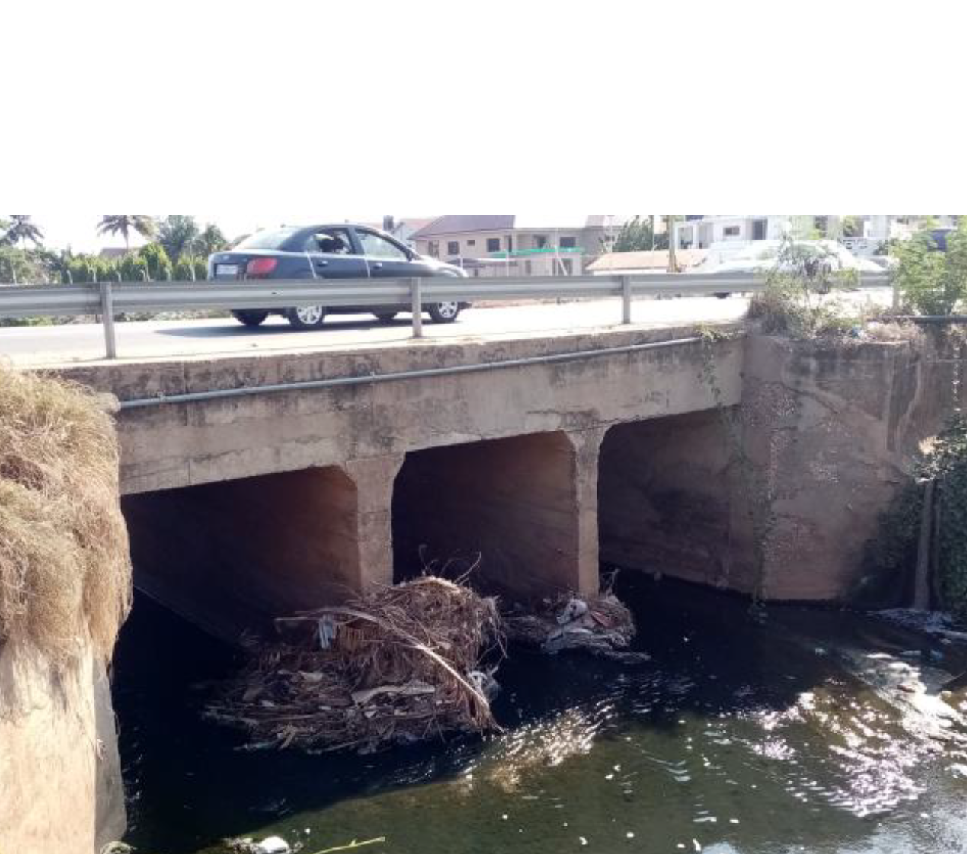
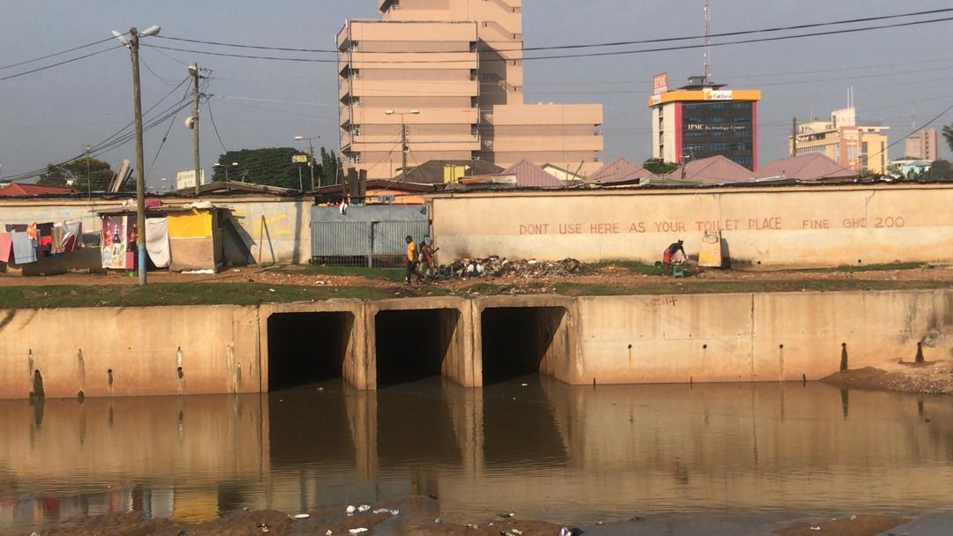
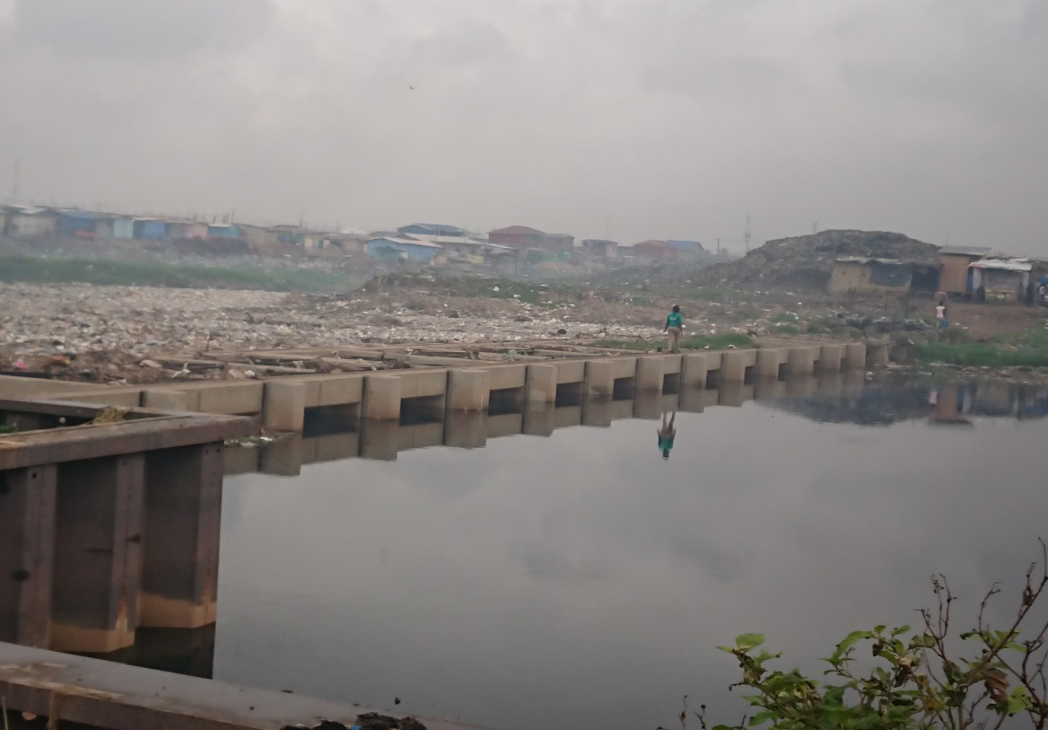
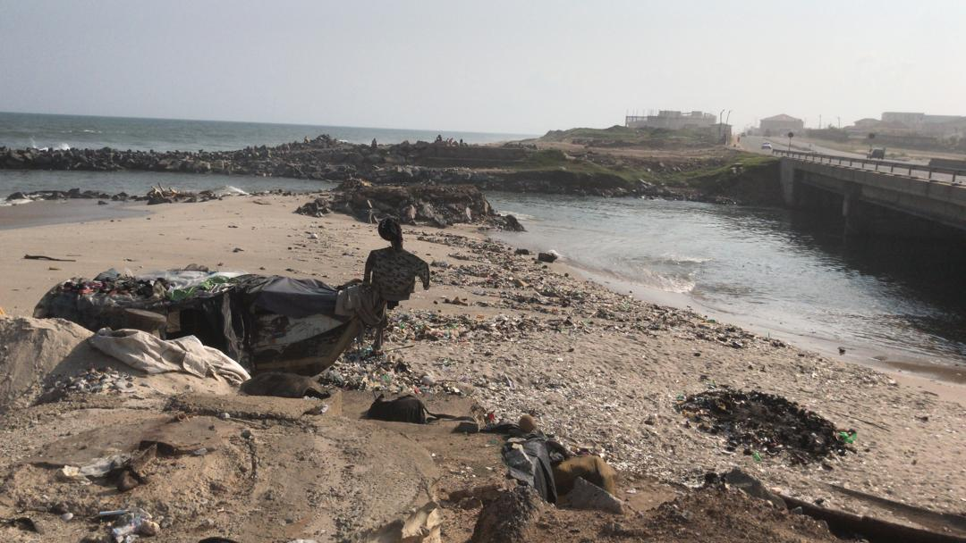
GARID Project Interventions
Odaw Basin – Structural Measures
Dredging Works Channel Reconstruction Bridge Widening
Nima drain confluence Interceptor Weir River Outlet Configuration

Slide 15
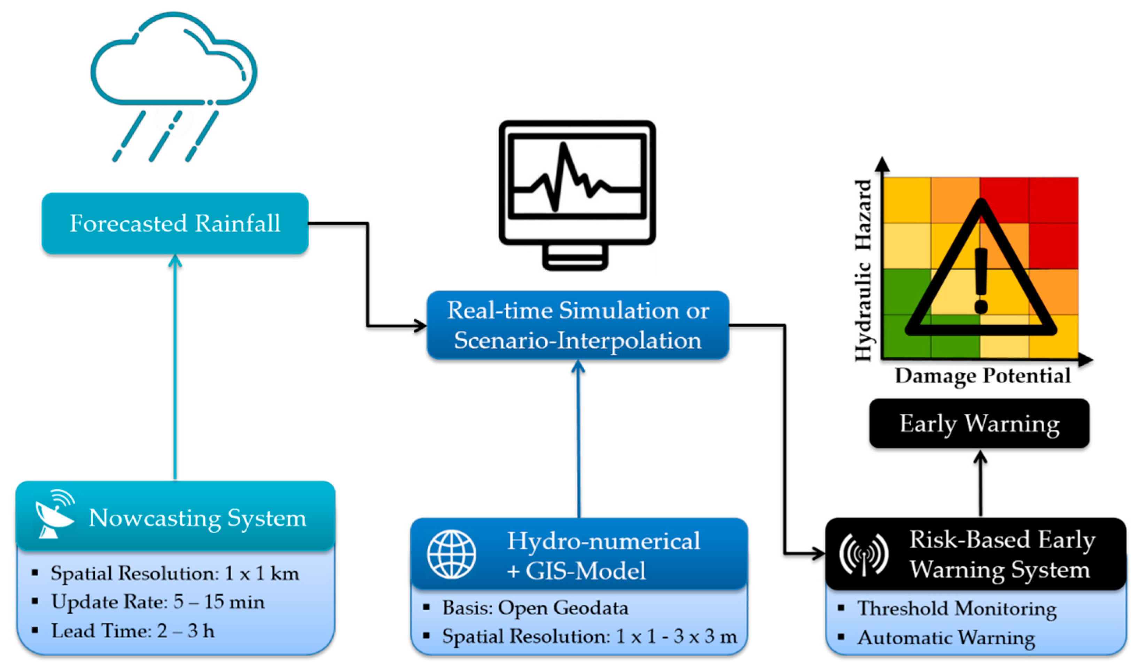
GARID Project Interventions
Greater Accra Region - Non Structural Measures
NADMO
HSD
(Ghana Hydrological Authority)
GMET
Flood Early Warning System – FEWS Accra
Key Institutions

Slide 16
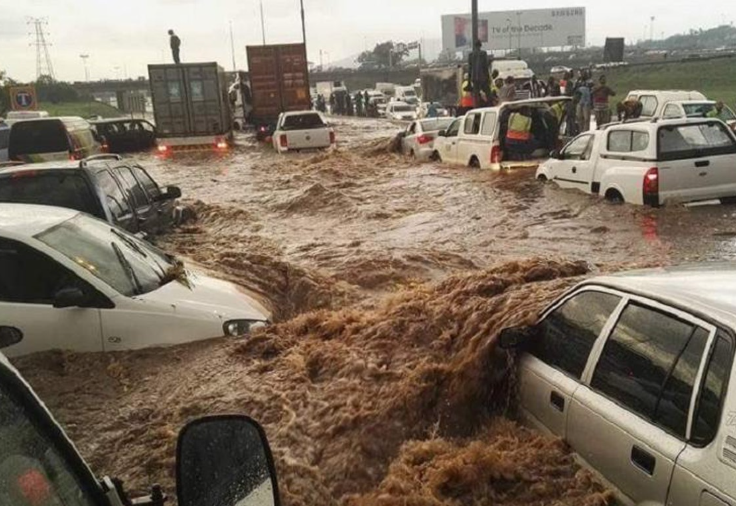
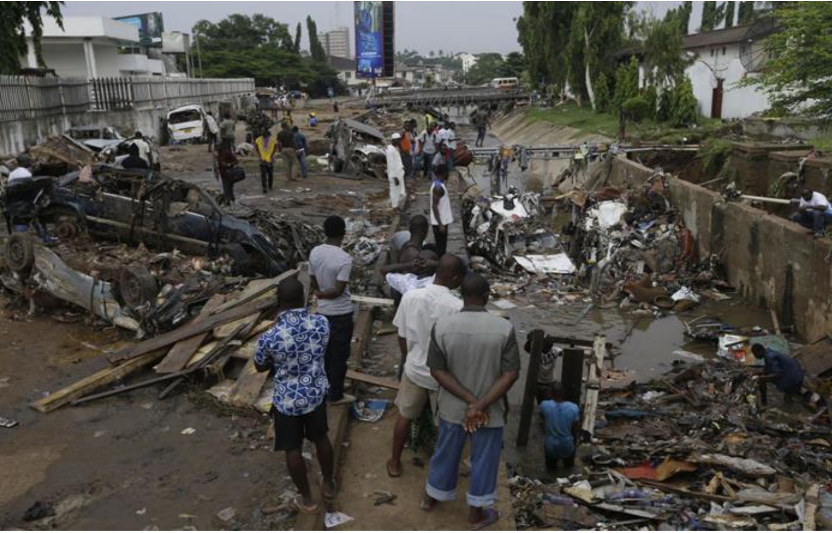
Background and Context
Objective of GARID Project Case Study
Case study demonstrates the use of computer modelling for T10 flood resilience planning in the Odaw Basin
Flood Resilience is the capability to anticipate, prepare, respond to and recover from flood hazards to minimize damage to social well-being, health, the economy and the environment.

Slide 17
Background and Context
Methodology
Flood Resilience Planning
Flood Model Development (hydrological and hydraulic models)
Flood hazard assessment of existing stormwater drainage infrastructure (current and future anticipated scenarios)
Simulation of proposed structural measures for mitigating flood risk.
"Recommended Practice: Flood Hazard Assessment (un-spider.org)
United Nations Platform for Space-based Information for Disaster Management and Emergency Response Knowledge Portal

Slide 18
Flood Model Development

Slide 19
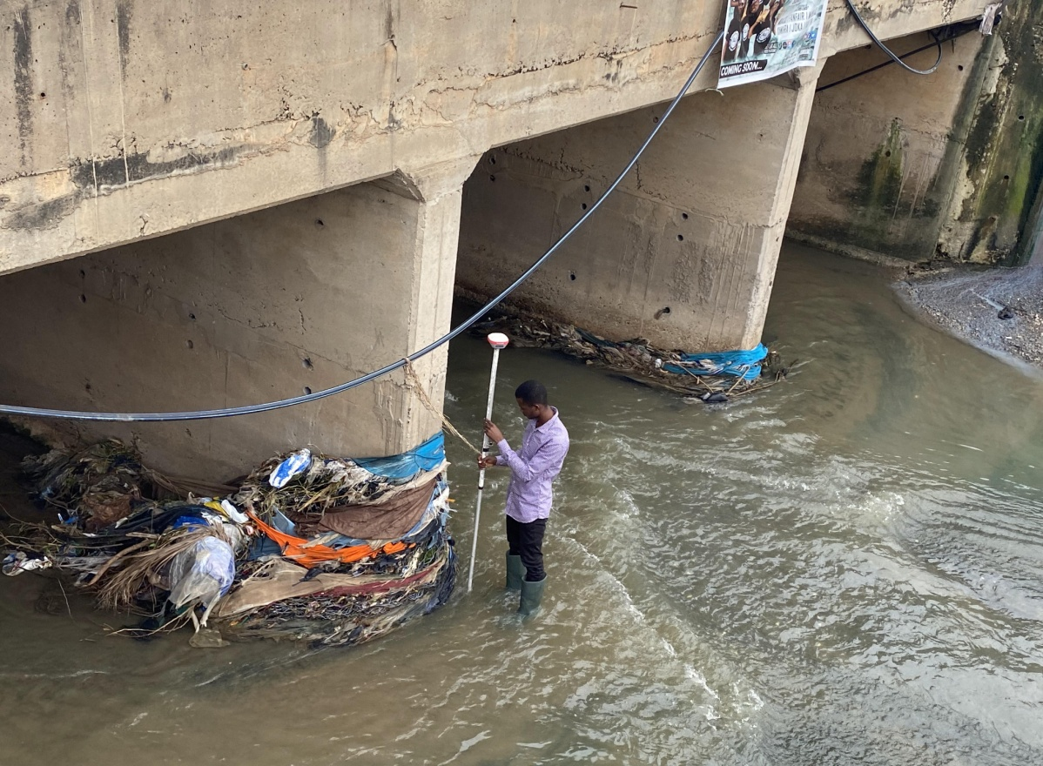
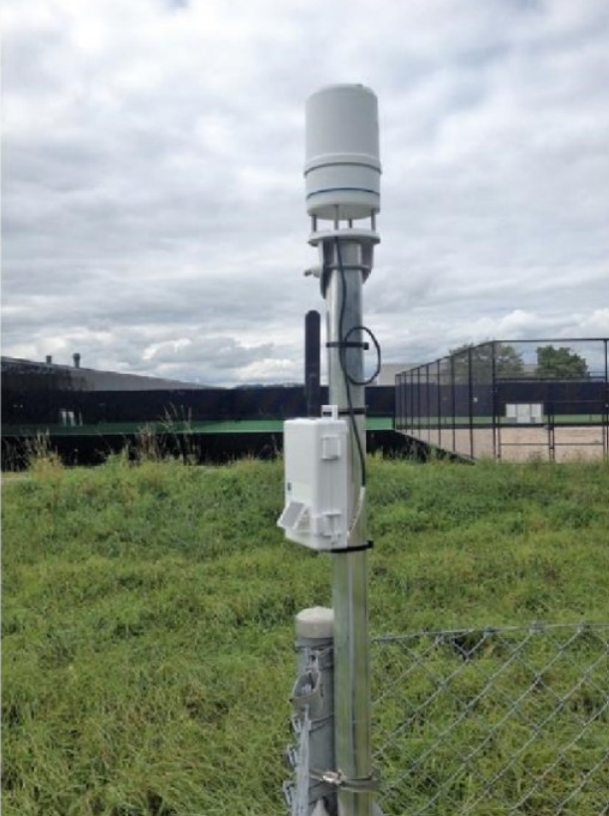
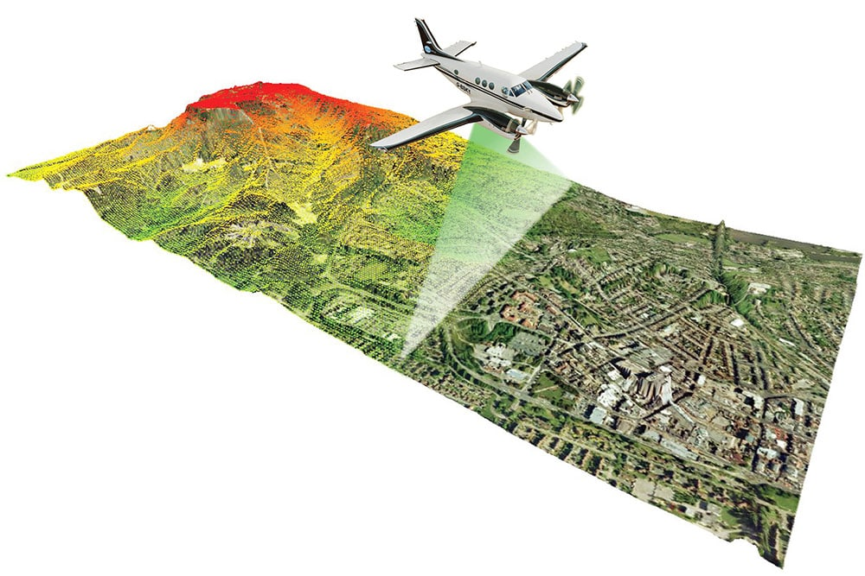
Flood Model Development
Data Collection
Field topographic surveys
0.5m resolution Digital Elevation Model (DEM) from the LiDAR survey
GMET time series

Slide 20
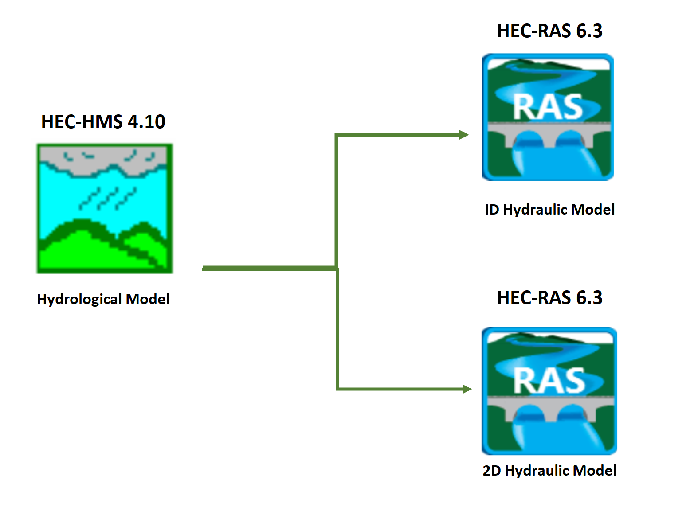
Flood Model Development
Flood Model Configuration
The HEC-HMS software was developed by the U.S. Army Corps of Engineers Hydrologic Engineering Center.
HEC-HMS is designed to simulate the precipitation-runoff processes of dendritic drainage basins.
The HEC-RAS software was also developed by the U.S. Army Corps of Engineers Hydrologic Engineering Center.
HEC-RAS can be used for modelling one-dimensional (1D) and two-dimensional (2D) in-stream and floodplain hydraulics.

Slide 21
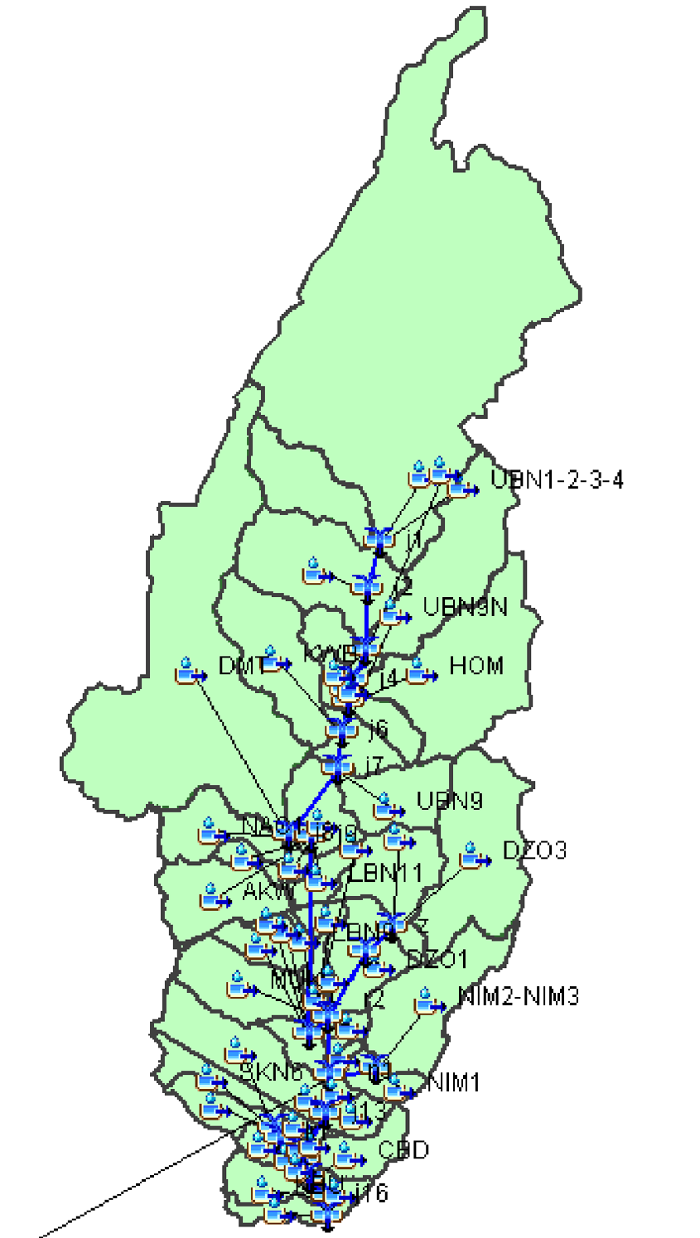

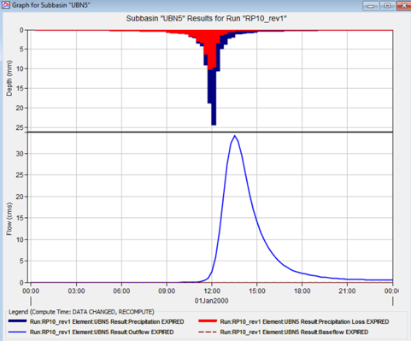
Flood Model Development
Hydrologic Modelling with HEC-HMS
Model Elements
50 subbasin elements
21 reach elements
21 junction elements
Basin Parameters
Loss Method – SCS Curve Number
Transform Method - SCS Unit Hydrograph
Reach Parameters
Routing Method - Muskingum-Cunge
Junction Elements are not assigned parameters.
In the absence of historical streamflow data for model calibration and verification, a sensitivity analysis procedure was adopted to determine how variations on the values of these parameters (i.e. CN) could affect computed discharges (Mott MacDonald, 2006).

Slide 22
Flood Model Development
1D Hydraulic Modelling with HEC-RAS
Drainage Channels
Odaw River
Mususku drain
Onyasia drain
Nima drain
South Kaneshie drain
Hydraulic Structures
Achimota Forest Road Crossing
Dome Pillar 2 Road Crossing
G. Bush Motorway Crossing
Ring Road Central Crossing
Odawna Railway Bridge Crossing
Graphic Road Crossing
Based on literature a range of expected parameter values was determined applicable based on the peculiar catchment characteristics.
By using an iterative process, the final calibrated model values were determined (ARS Progetti, 2021).
The selected tributaries have very high incidence of observed flooding.
Location of retention ponds

Slide 23
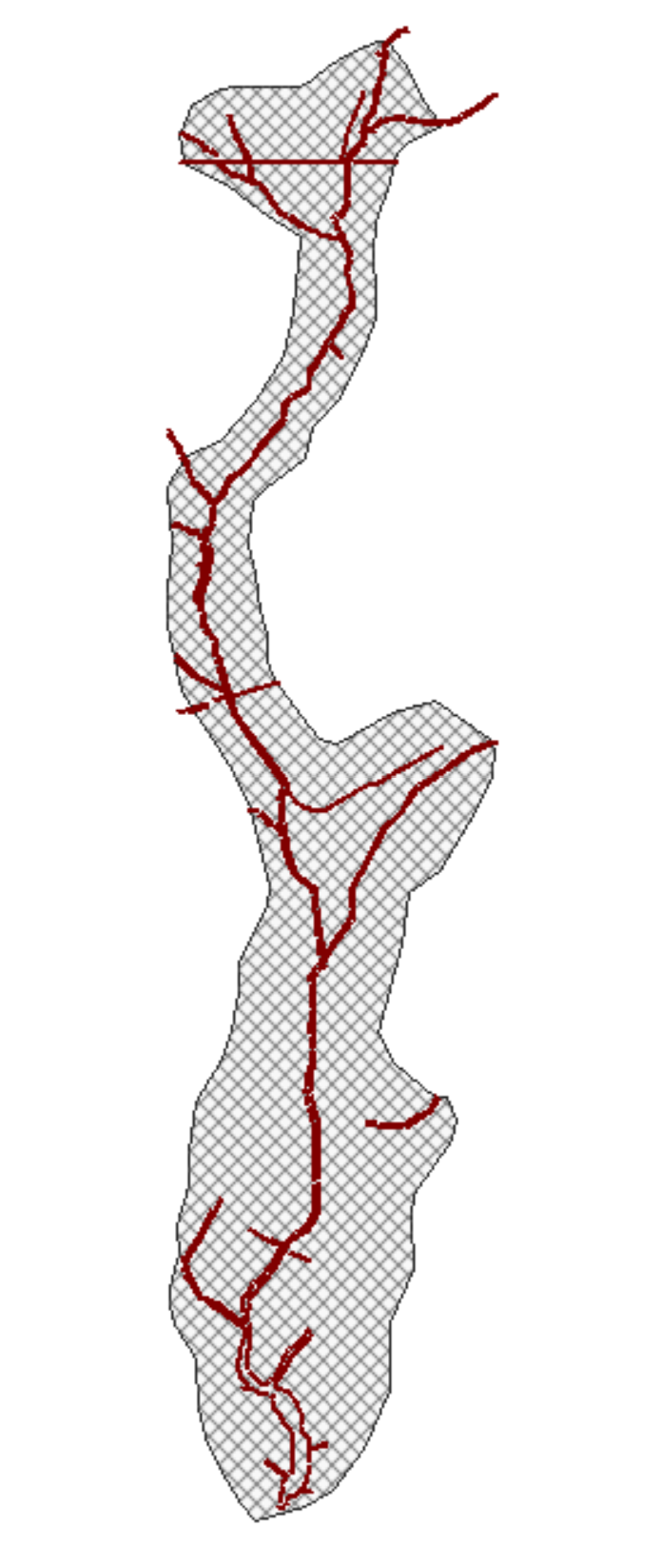
Flood Model Development
2D Hydraulic Modelling with HEC-RAS
The 2D model is used to compare the flooded areas in the current and design scenarios and also determine the residual risk (Impact of proposed flood risk mitigation measures).
The geometry of the 2D model covers the area from the Atomic to the sea.
The computation mesh is made of 112,000 cells (15x15 meters maximum).
Breaklines were used to detail the mesh (i.e. along the river, the embankments and morphological discontinuities).
Specific elements (2D connections) were used to describe the most significant hydraulic structures.
A roughness map was created to consider different values to be assigned at the area characterized by river/vegetation/buildings etc.
Boundary conditions consisted of 27 flow hydrographs and 1 stage hydrograph for the river outlet.

Slide 24
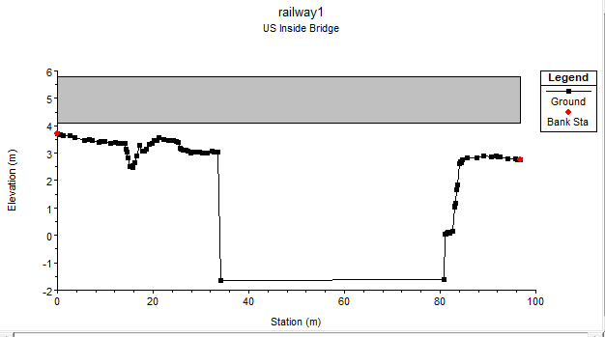
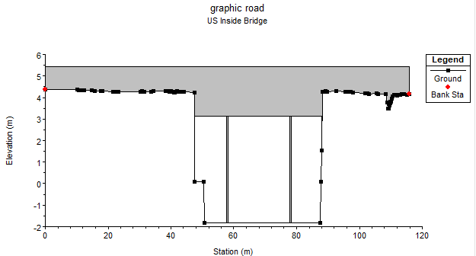
Flood Model Development
2D Hydraulic Modelling with HEC-RAS
Hydraulic Structures
Hydraulic structures were included in the hydraulic model using the SA/2D Area Conn option
Railway Bridge (Proposed)
Graphic Road Bridge (Existing)

Slide 25
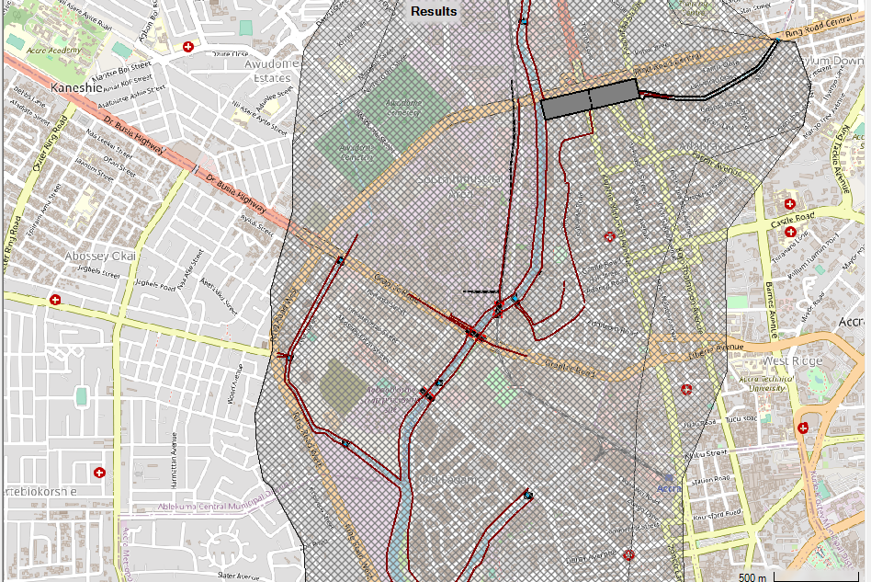

Slide 26
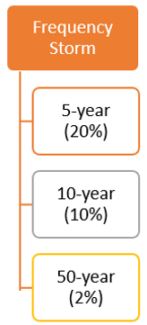
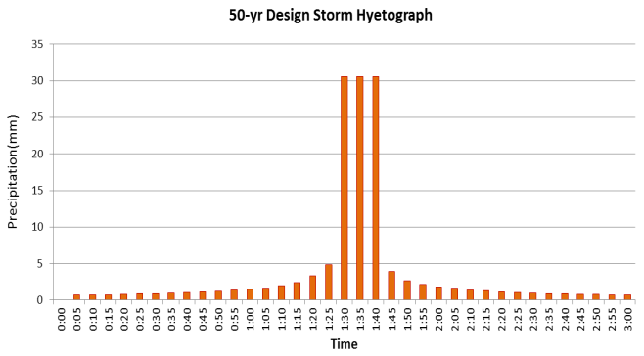
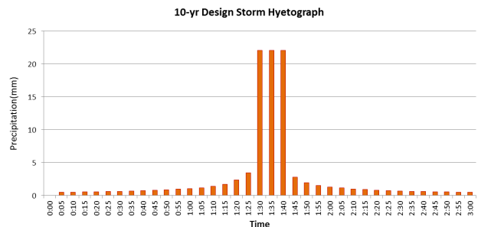
Flood Model Development
Frequency Storm Modelling Scenarios

Slide 27
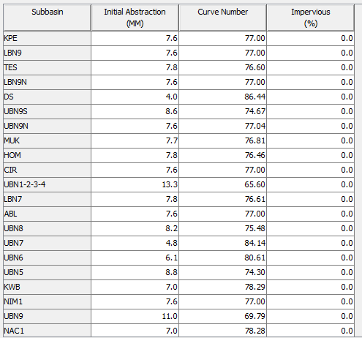

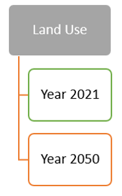
Flood Model Development
Landuse Modelling Scenarios
Current Landuse
Year 2050 Landuse

Slide 28
Flood Hazard Assessment (Worse Case Scenario)

Slide 29
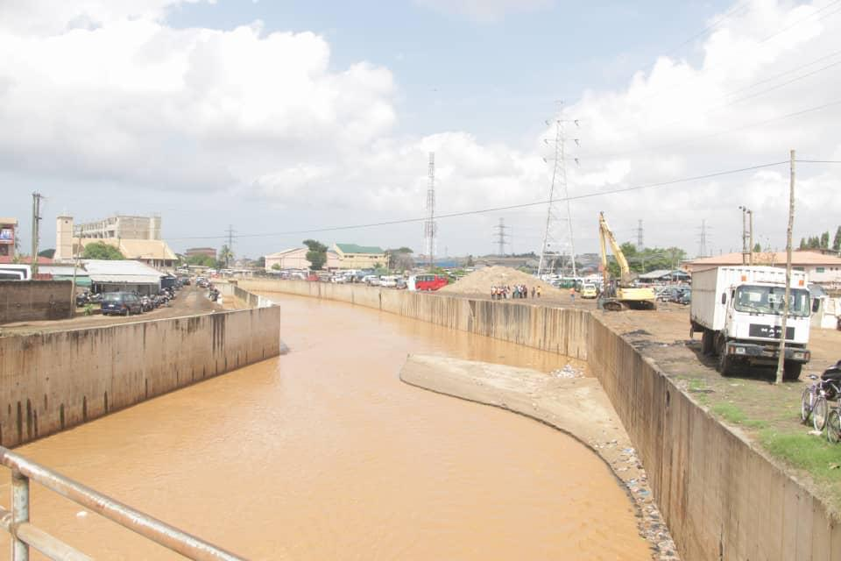
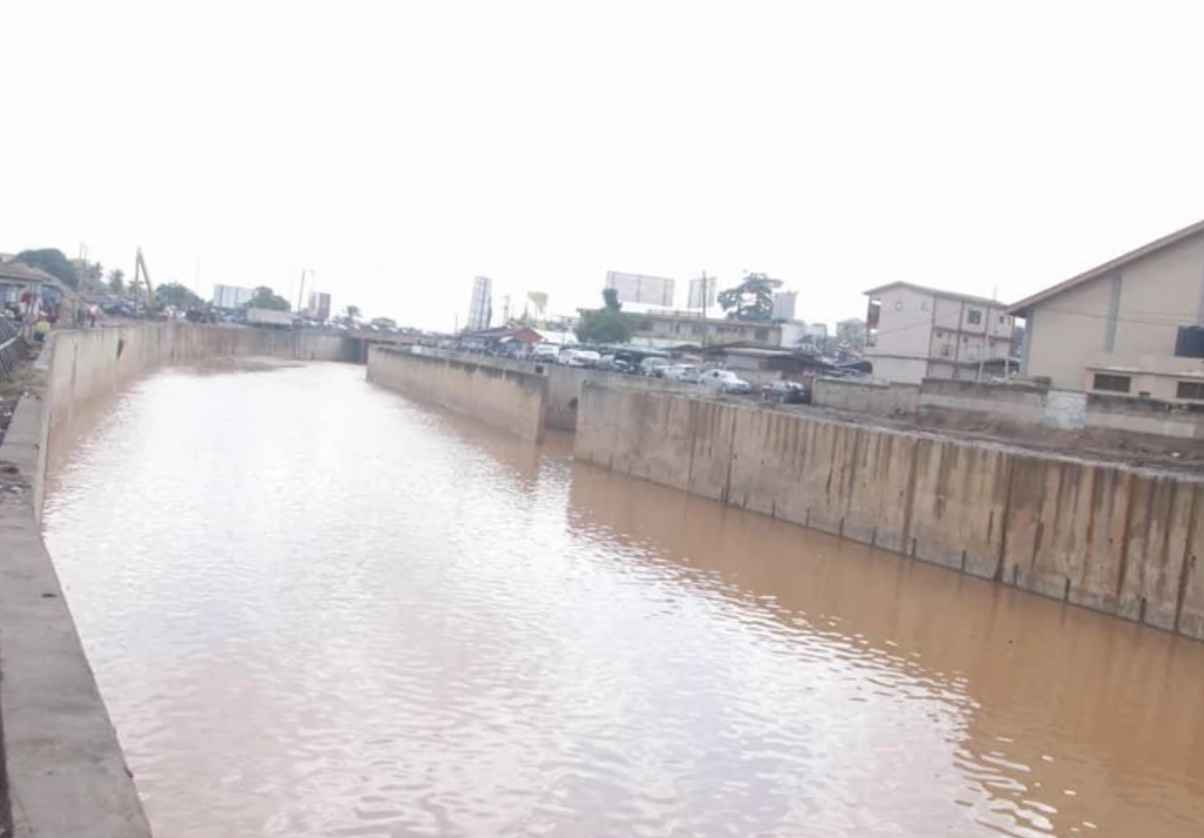
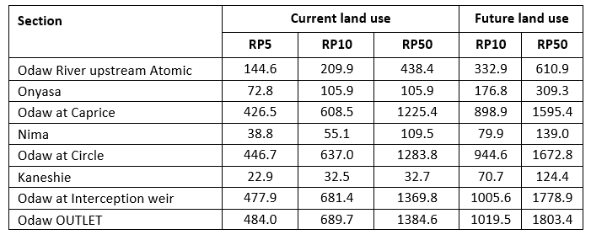
Flood Hazard Assessment
Peak Flood Discharges
Location

Slide 30
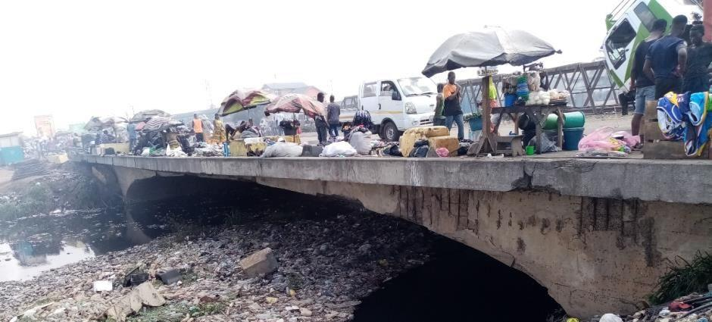
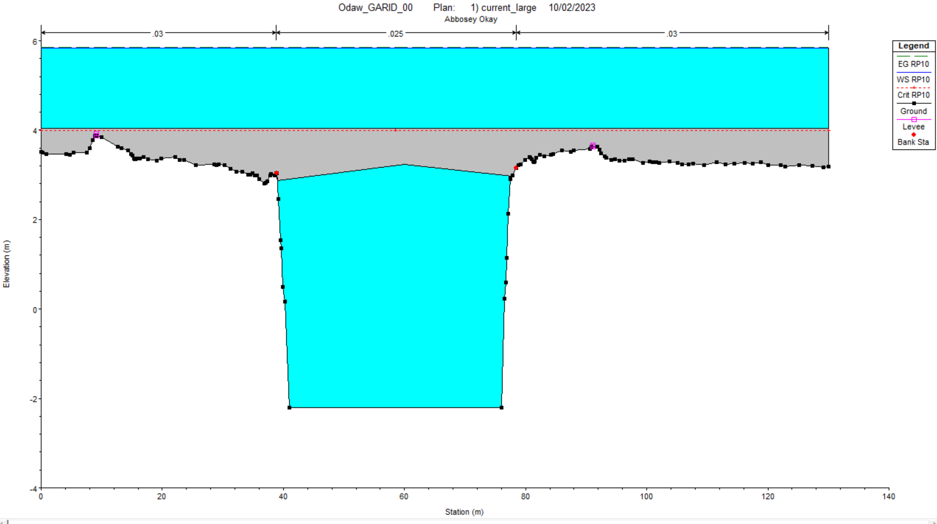
Flood Hazard Assessment
T10 Hydraulic Capacity of Abossey Okai Road Bridge

Slide 31
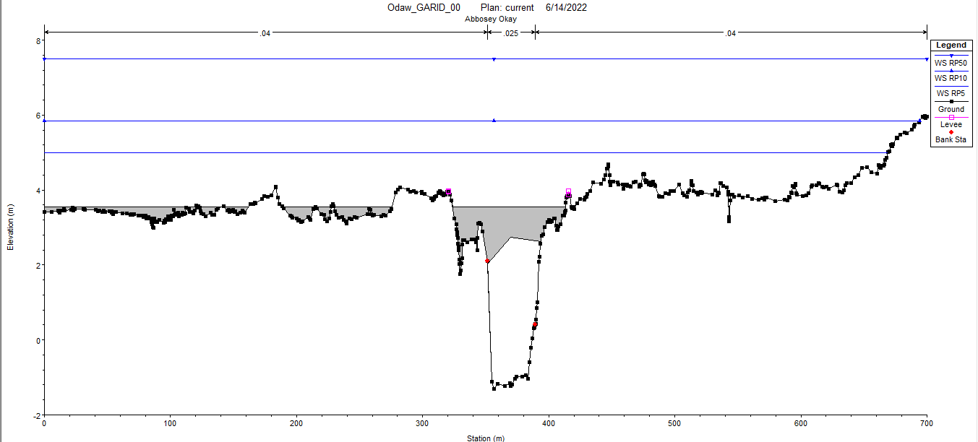
Flood Hazard Assessment
Abossey Okai Road Bridge Water Surface Level - T5/T10/T50

Slide 32
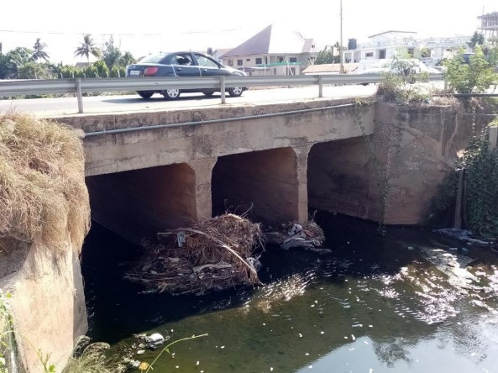
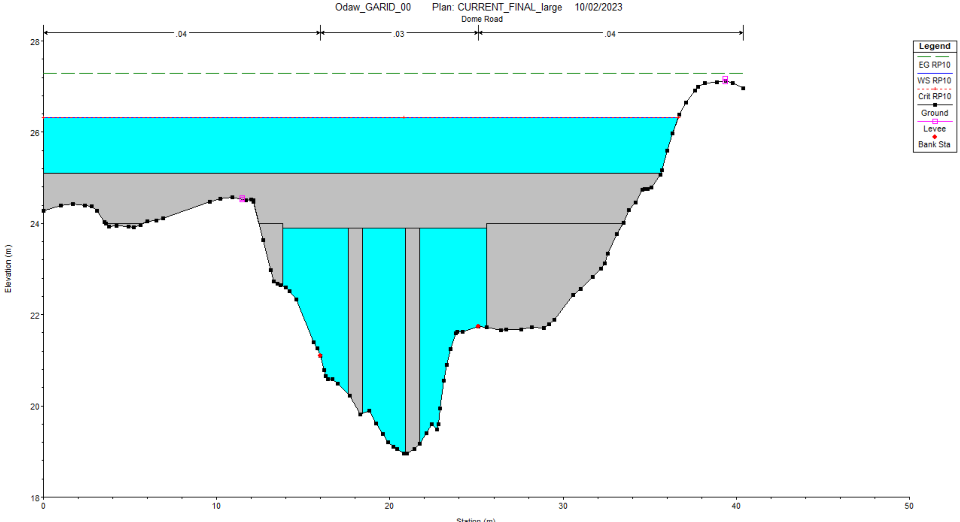
Flood Hazard Assessment
T10 Hydraulic Capacity of Dome Pillar 2 Road Bridge

Slide 33
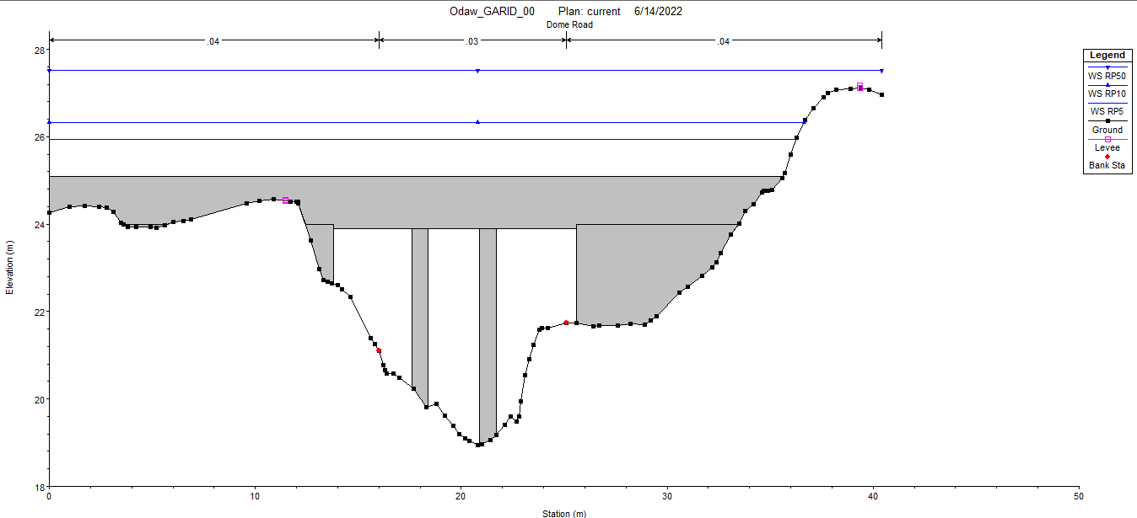
Flood Hazard Assessment
Dome Pillar 2 Road Bridge Water Surface Level - T5/T10/T50

Slide 34
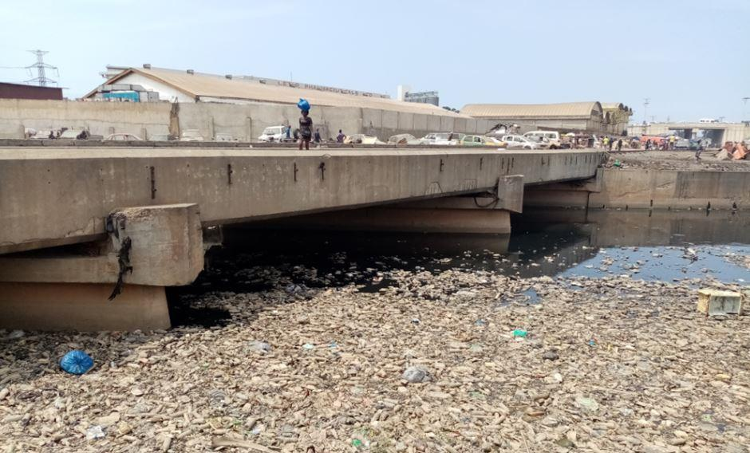
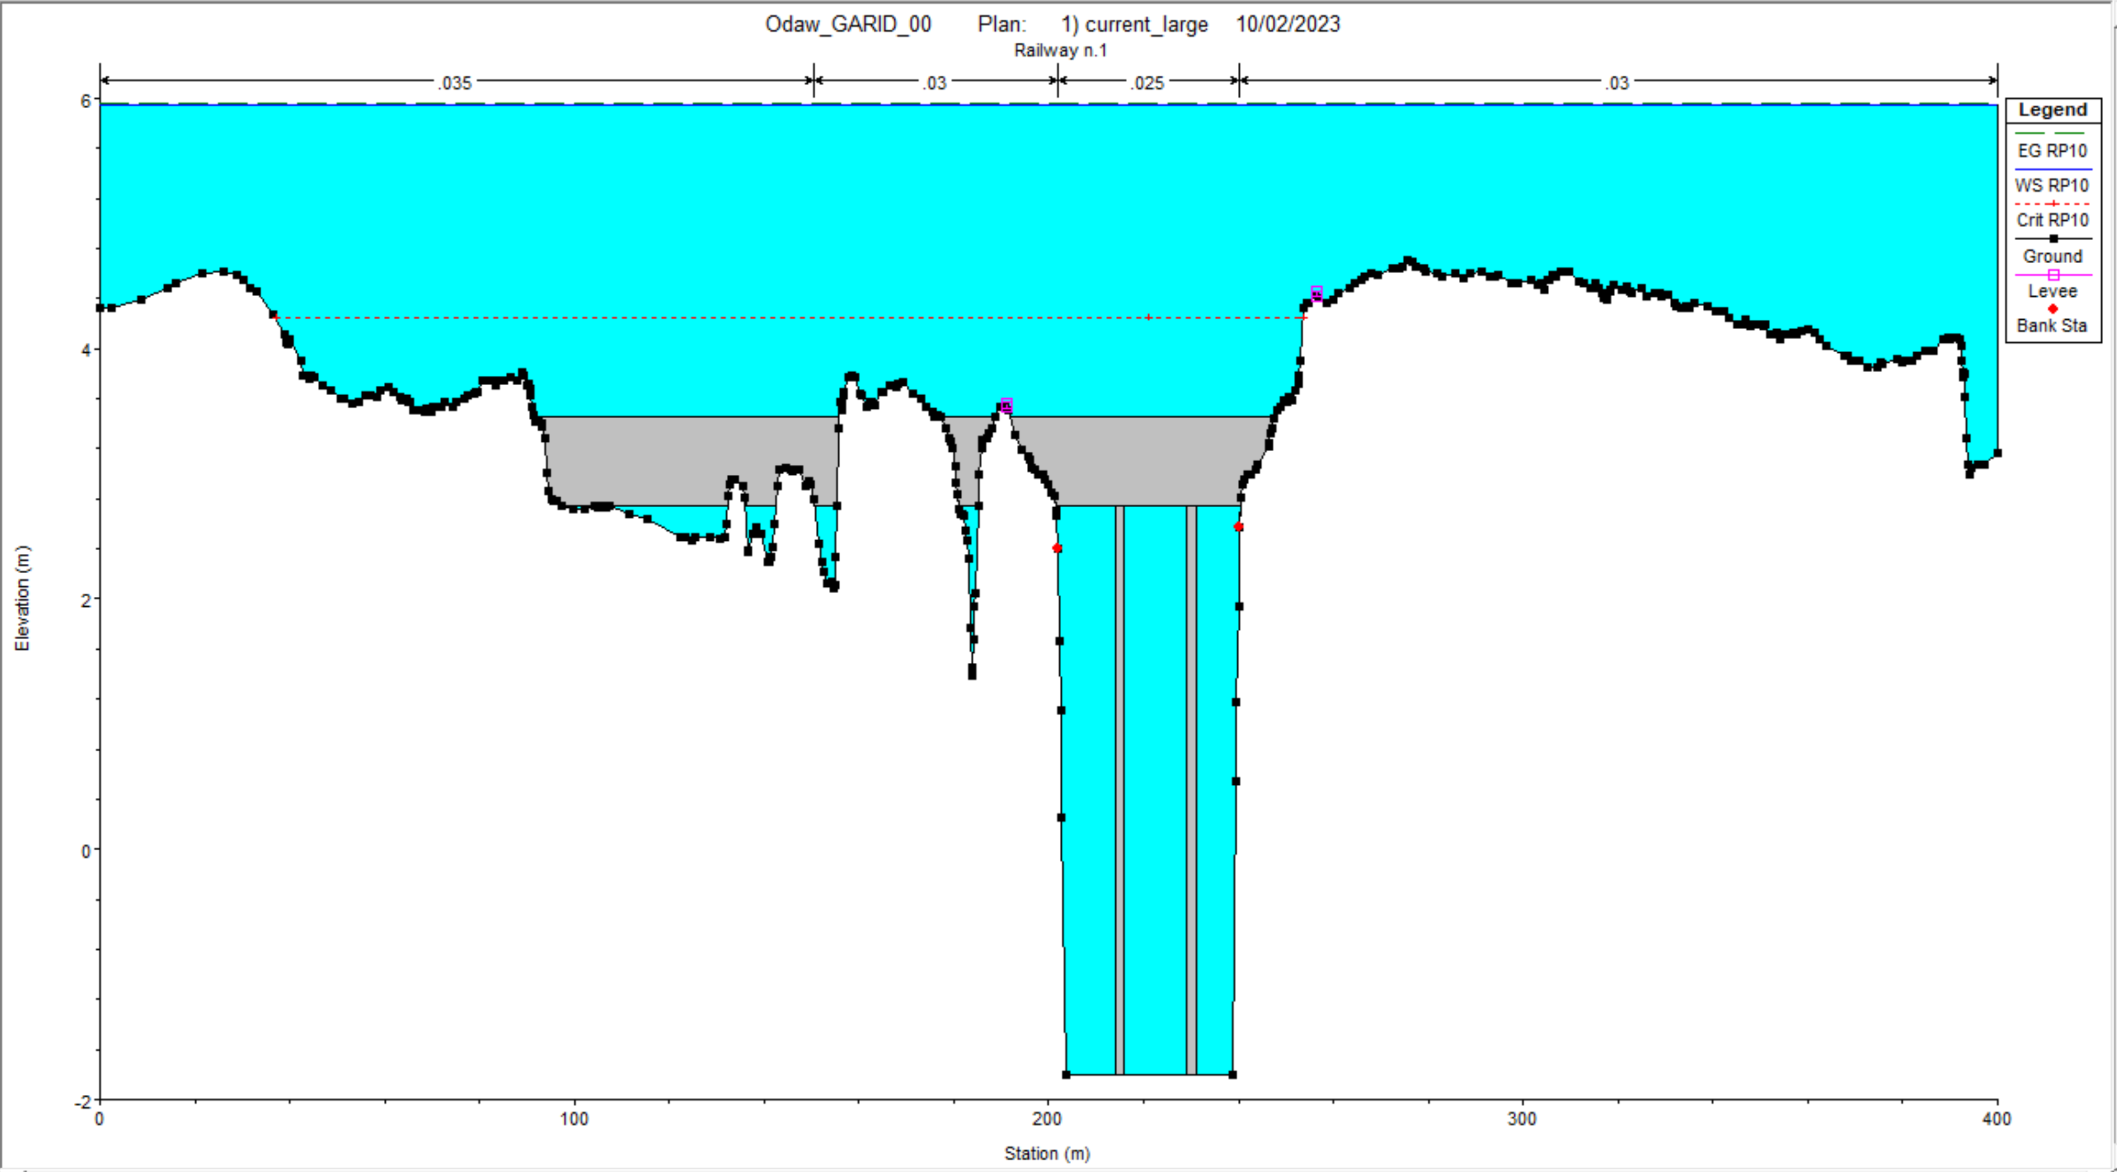
Flood Hazard Assessment
T10 Hydraulic Capacity of Odawna Railway Bridge

Slide 35
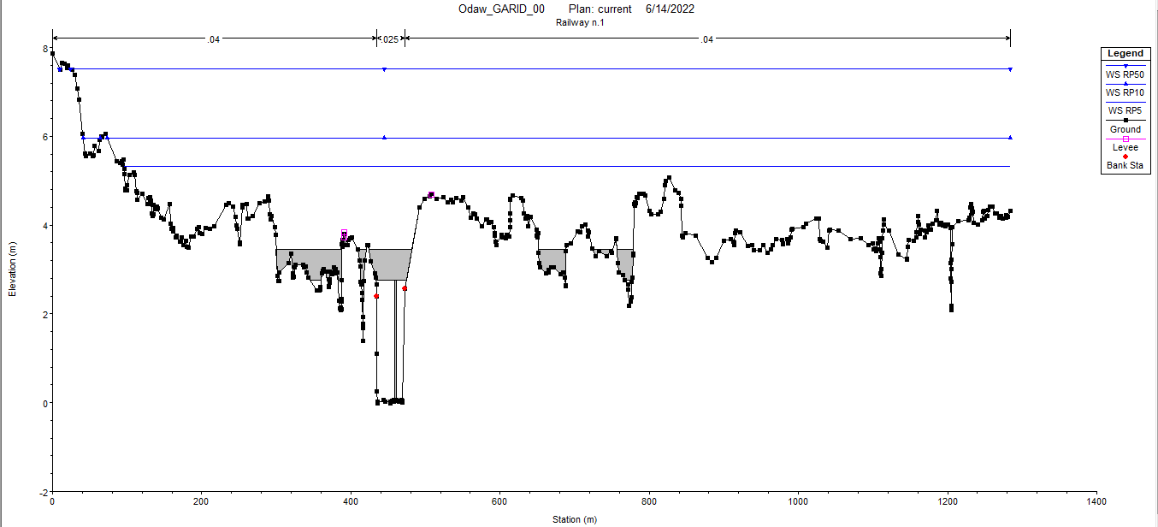
Flood Hazard Assessment
Odawna Railway Bridge Water Surface Level - T5/T10/T50

Slide 36
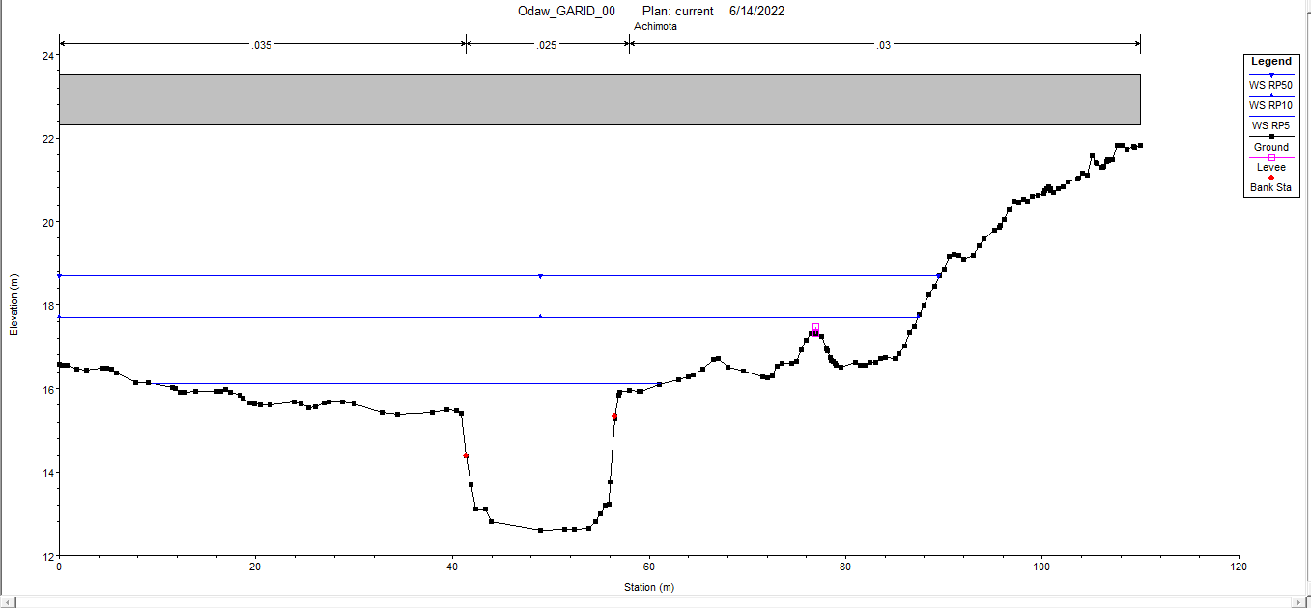
Flood Hazard Assessment
Achimota Forest Road Bridge Water Surface Level - T5/T10/T50

Slide 37
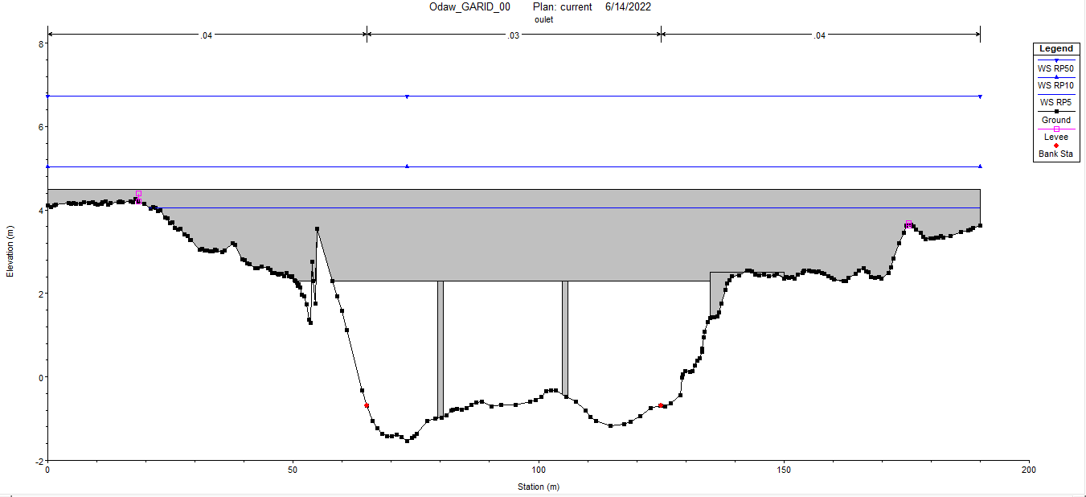
Flood Hazard Assessment
Odaw Outlet Bridge Water Surface Level - T5/T10/T50

Slide 38
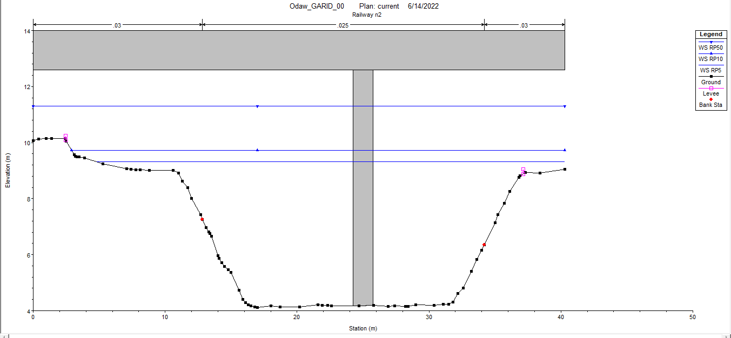
Flood Hazard Assessment
Abelenkpe Railway Bridge Water Surface Level - T5/T10/T50

Slide 39
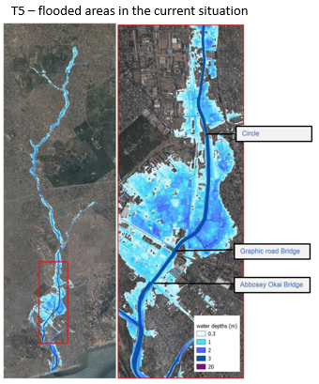

Flood Hazard Assessment
T5 and T10 Flooded Areas
Avenor
Kpehe
Kokomlemle
Asylum Down
Adabraka (Sahara)
Kaneshie
Mataheko
Abossey Okai
Korle Dudor
Sabon Zongo
Zoti
Adedenkpo (Old Fadama)
Korle Bu

Slide 40



Flood Hazard Assessment
T5 and T10 Flooded Areas

Slide 41
Evaluation of T10 Flood Mitigation Measures

Slide 42
Evaluation of T10 Flood Mitigation Measures
Proposed Basin Wide Flood Mitigation Measures (Fixed Budget)
Retention Ponds – Atomic West, Atomic East
Odaw River Channel Improvement – Achimota section, Old Fadama section, River outlet
Nima Channel Improvement
South Kaneshie Channel Improvement
Bridge Replacement– Dome Pillar 2, Abossey Okai, Odawna Railway, South Kaneshie

Slide 43

Evaluation of T10 Flood Mitigation Measures
Peak Flow Attenuation
The storage reservoir concept for flood management and planning has been proposed by (Ametefe, 2009) for the urbanized Mamhuma catchment which is also located in the Greater Accra Region.
25% T10 peak flow attenuation i.e. from 212 m³/s to 160 m³/s

Slide 44


Evaluation of T10 Flood Mitigation Measures
Reduction in Flood Water Level at the Dome Pillar 2 Road Bridge

Slide 45

Evaluation of T10 Flood Mitigation Measures
Reduction in Flood Water Level at Abossey Okai Road Bridge

Slide 46

Evaluation of T10 Flood Mitigation Measures
Reduction in Flood Water Level at Odawna Railway Bridge

Slide 47


Evaluation of T10 Flood Mitigation Measures
Reduction in Flood Water Level at Odaw River Outlet Bridge

Slide 48


Railway Bridge
Abossey Okai Bridge

Slide 49

Evaluation of T10 Flood Mitigation Measures
Reduction in T5 Flood Inundation Areas
Avenor
Kpehe
Kokomlemle
Asylum Down
Adabraka (Sahara)
Kaneshie
Mataheko
Abossey Okai
Korle Dudor
Sabon Zongo
Zoti
Adedenkpo (Old Fadama)
Korle Bu

Slide 50

Evaluation of T10 Flood Mitigation Measures
Reduction in T5 Inundation Areas

Slide 51

Evaluation of T10 Flood Mitigation Measures
Reduction in T10 Flood Inundation Areas
Avenor
Kpehe
Kokomlemle
Asylum Down
Adabraka (Sahara)
Kaneshie
Mataheko
Abossey Okai
Korle Dudor
Sabon Zongo
Zoti
Adedenkpo (Old Fadama)
Korle Bu

Slide 52


Slide 53

Evaluation of T10 Flood Mitigation Measures
Reduction in T10 Inundation Areas

Slide 54
Summary of Key Findings

Slide 55
Summary of Key Findings
Key Findings
The lower reaches of the Odaw Basin i.e. (Caprice Area – Odaw Outfall) can be categorized as a very high risk flood zone as a result of the extent of inundation for T5 and T10 flood events which tend to occur frequently.
The existing Odawna Railway bridge and the Abossey Okai Road bridge have inadequate hydraulic capacity for the conveyance of both T5 And T10 worse case flood events (i.e.. where there is simultaneous rainfall throughout the entire Odaw Basin).
Unregulated land development in the upper reaches of the Odaw Basin (i.e. Atomic, Berekusu, Aburi) if allowed to persist will most likely result in over 50% increase in peak discharge by Year 2050.
The GARID Project interventions (structural measures) if successfully implemented will result in a 40% reduction in flood inundation extent within the lower reaches of the Odaw Basin. The most significant will be construction of the Atomic East and Atomic West retention ponds.
Residual flooding will still occur within the Odaw Basin inspite of the proposed structural measures under the GARID Project. Communities that will still face flood hazards include Adabraka (Sahara), Kaneshie, Mataheko, Avenor and Kokomlemle.

Slide 56
Limitations for Study

Slide 57

Limitations
Limitations for GARID Case Study
Similar constraints as reported in previous modelling studies in GAMA (WAPCOS, 2019; Mott MacDonald, 2006)

Slide 58

Limitations
GARID Project Interventions (Addressing Limitations)

Slide 59



Data Related Activities under GARID Project
Acquisition of Hydro-Meteorological Equipment
Non-Contact Water Level Radars
Water Flow Meters
Automatic Weather Stations

Slide 60
Conclusions and Recommendations

Slide 61
Conclusion and Recommendation
Conclusion
The utilization of flood modelling as a decision support tool for flood resilience planning has been effectively demonstrated using the GARID Project as a Case Study.
The decision maker's ability to anticipate, prepare and respond to flood hazards within the Odaw Basin both in the present circumstances as well as for a wide range of potential scenarios in the future is very crucial especially in national and local government funding for disaster risk mitigation is limited.
The storage reservoir concept for flood management as applied within the Odaw Basin and demonstrated with the flood model simulation will result in significant minimization of damage to social well-being, health, the economy and the environment in downstream communities.

Slide 62
Conclusion and Recommendation
Recommendation – Strategic Policy Interventions
Land use in the Ga West, Ga East, Ga North and Akuapem South municipalities should be properly regulated to minimize the anticipated future loss of life and destruction of property that will be associated with flooding in the high risk flood prone areas downstream.
There should be a deliberate policy by GhIE/KNUST to develop the next generation of flood risk management experts to deal with our anticipated future flooding hazards. The GhIE can in the short to medium term:
Facilitate the development of technical guidelines and design manuals for urban stormwater drainage
Organize training workshops and seminars on international best practices in flood hazard and flood risk management.
Open access data platforms are required to make hydro-meteorological data easily accessible for built environment professionals as pertains in other jurisdictions. Poor quality of data results inadequate hydrologic and hydraulic design which is detrimental to national development.

Slide 63
Conclusion and Recommendation
Recommendation – Future Modelling Studies
The 1-D and 2-D flood models used for the study should be upgraded to include all the major tributaries in the upper reaches of the Odaw Basin including the Dome-Taifa, Laador, Haatso, Oyinase and Ado streams. This will represent a fully integrated basin wide resilience planning approach.
Further multi-disciplinary studies on exposure and vulnerability assessment within the Odaw Basin using public domain software such as HEC-FIA (Flood Impact Assessment) and HEC-FDA (Flood Damage Assessment) should be considered

Slide 64
Acknowledgement
Dr. Ohene Sarfo (GARID Project Coordinator)
Dr. William Kodwiw (GARID PCU)
Dr. John Kissi (Ghana Hydrological Authority)
Mr. Ben Makafui Agbelengor (GARID PCU)
Mr. Enoch Gyasi (MWH)
ARS Progetti/Sering JV (Design Consultants)

Slide 65
Questions

