Slide 1
GEOTECHNICAL SITE CHARACTERIZATION USING MULTICHANNEL ANALYSIS OF SURFACE WAVES(MASW) & PASSIVE SEISMIC (HORIZONTAL TO VERTICAL SPECTRAL RATIO-HVSR)
(“Near Surface Geophysics and Beyond”)
BY: ING. EMMANUEL KOFI BOATENG
(PE-MGhIE, MSEG, MEEGS, MIAH, Nebosh)

Slide 2
(“Near Surface Geophysics and Beyond”)
PRESENTATION OUTLINE
WHAT IS MASW?
HOW IS IT ACQUIRED?
RESULTS OF MASW SURVEY?
WHAT INFORMATION DOES IT PROVIDE?
APPLICATION & ADVANTAGES OF MASW
PASSIVE SEISMIC (HORIZONTAL TO VERTICAL SPECTRAL RATIO-HVSR)
CONCLUSION

Slide 3
WHAT IS MASW?
MASW is an acronym of Multichannel Analysis of Surface Waves. It is a seismic exploration technique first introduced in GEOPHYSICS by (Park, Miller and Xia, 1999).
A typical MASW survey requires a seismic source to generate surface waves, and a minimum of two geophone receivers to measure the ground response at some distance from the source.
The seismic source used can be either active or passive depending on the application and location of the survey. Examples of actives seismic sources include explosives, weight drops, sledgehammer, and vibrating pads; while that of passive sources are road traffic, microtremors and water wave action.
The propagation velocities of surface waves through subsurface material are then analysed through their dispersion image, fundamental mode picking and then finally a shear-wave velocity (Vs) depth profile for the subsurface.
Notes:
Talk about Passive MASW and its acqusition, usually in a heavy traffic areas in Urban Centres. stifnness is a measure of a material’s resistance to deformation, and ultimately related to the material’s elastic moduli which describes the material’s behaviour under stress.

Slide 4
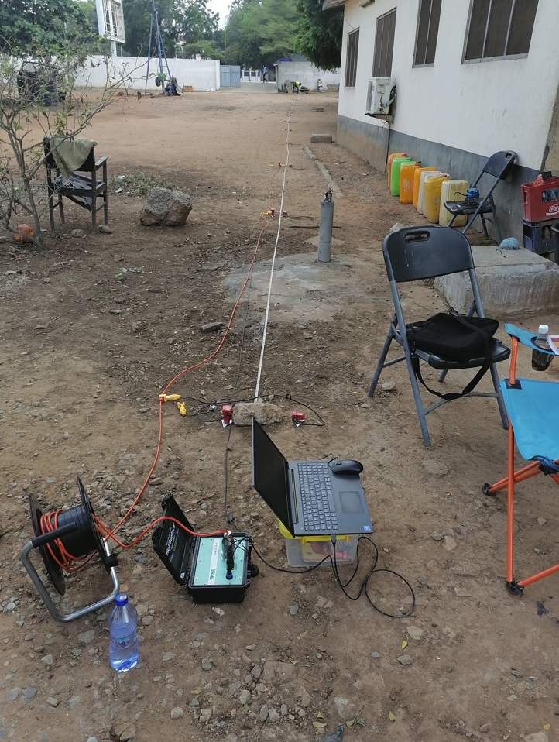
How is it acquired-Field Setup?
1-D & 2-D MASW field data acquisition at Dabakala, TUC & Old Sekondi College.

Slide 5
Cont. How is it acquired-Field Setup?
2-D MASW Survey at the Primary & Secondary Crusher Area, Lafigué Gold Project, Endeavour Mining, Dabakala, Cote D’Ivoire.

Slide 6
Cont. How is it acquired-Field Setup?
2-D MASW Survey at the Secondary Screening Area, Lafigué Gold Project, Endeavour Mining, Dabakala, Cote D’Ivoire.

Slide 7
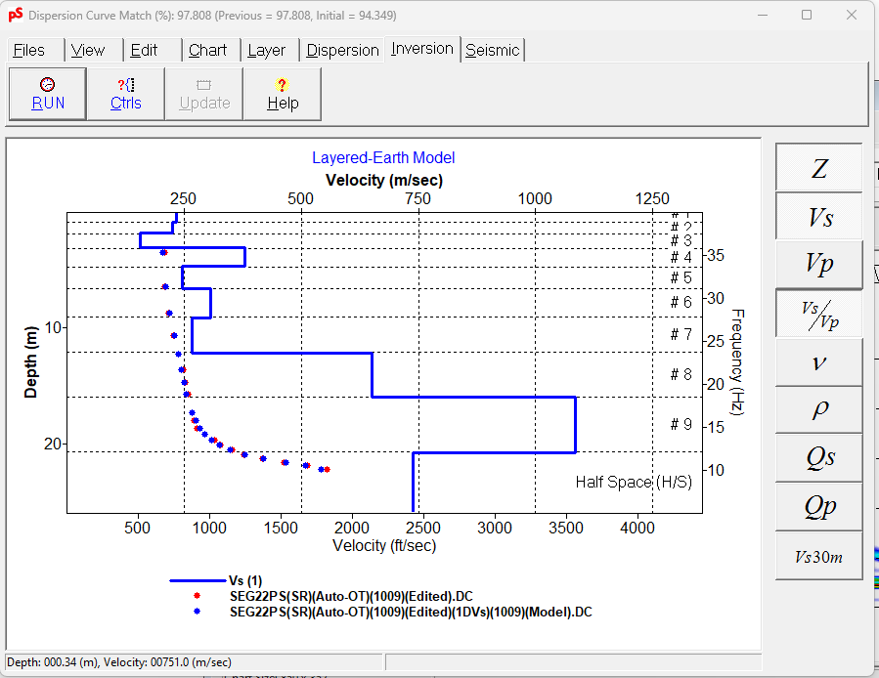
Cont. How is it acquired-Field Setup?
(A)
(B)
(C)

Slide 8
Result of MASW Survey, 2-D Shear Wave Velocity (V_{s}) Section
2-D Shear wave velocity section for MASW line BL100_CL, Primary & Secondary Crusher Area, Lafigué Gold Project, Endeavour Mining, Dabakala, Cote D’Ivoire.

Slide 9
Borehole logs correlation with MASW results. The rock starts from approximately 8m though the material gets stiffer from 5-6m. This is also seen from the MASW 2-D section above.

Slide 10
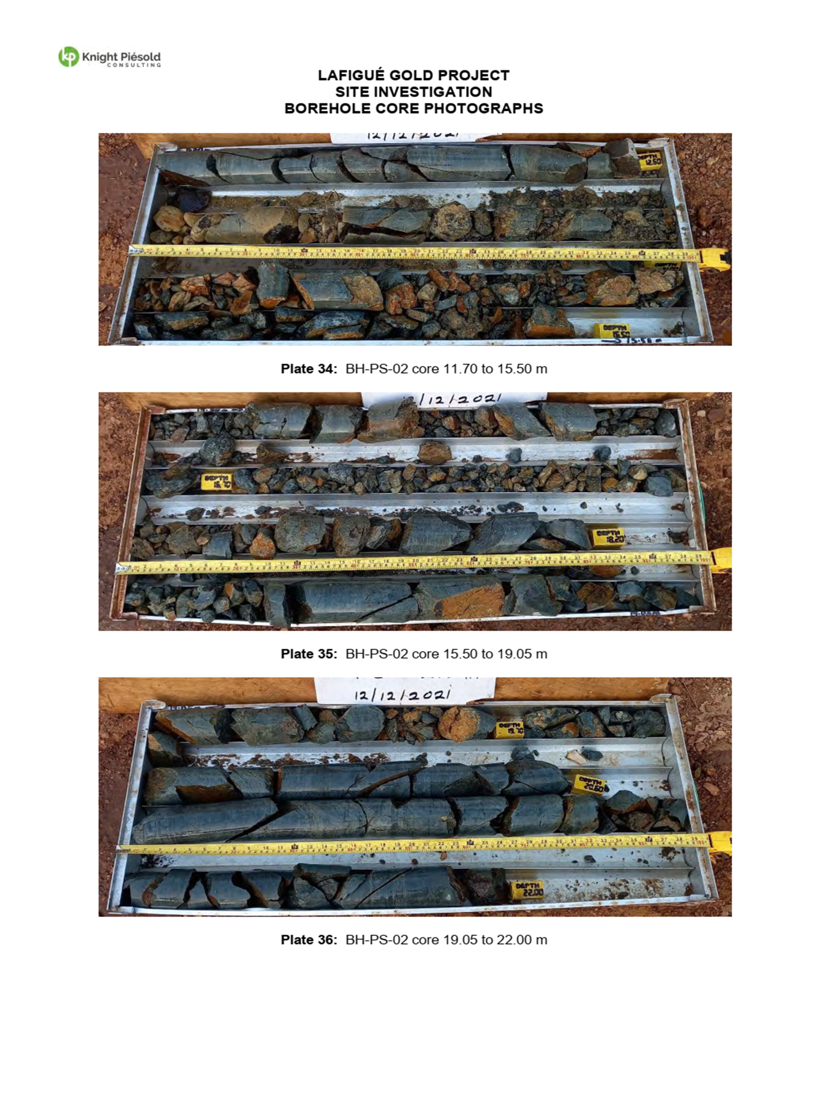
Borehole logs from 11.7-22m
From 12.5m the core recovery shows very broken rock to about 19m.
The MASW 2-D section also shows the reduction in shear velocity between these depths, an indication of a fractured medium.

Slide 11
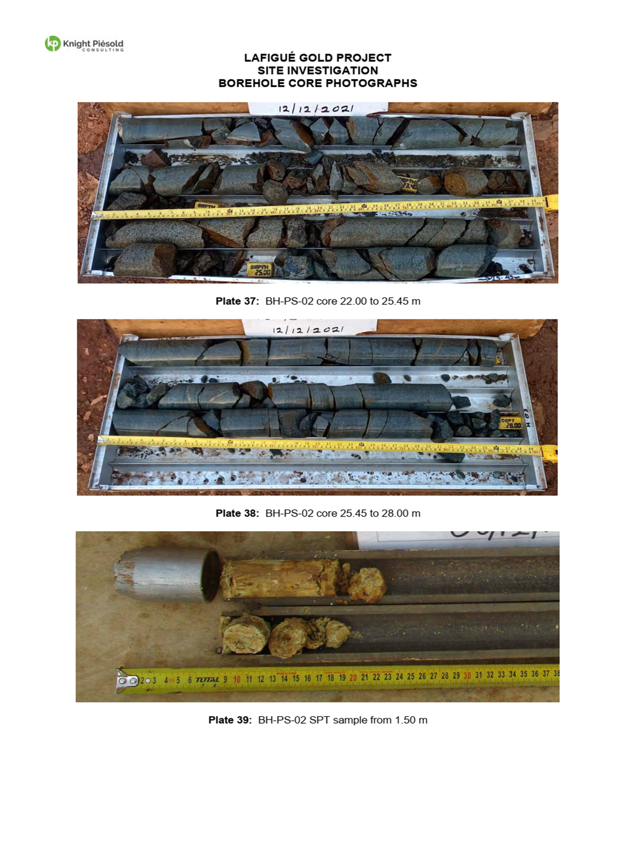
Borehole logs from 22m – 28m
Core retrieved from this depth is highly fractured

Slide 12
What Information Does MASW Provide?
Shear-wave velocity (Vs) is a direct indicator of the ground strength (stiffness).
Vs is one of the elastic constants and closely related to Young’s and Shear moduli and therefore commonly used to derive dynamic engineering properties such as Young’s modulus, Shear modulus, Poisson’s ratio, density, SPT-N values, site specific PGA, undrained shear strength of clay etc.
Provides information on Soil-Bedrock Mapping.
Vs can also be used to model site specific PGA.
It also provides information on the site class for Vs30m (top 0-30m) evaluation for seismic design consideration.
Compaction and Grouting Evaluation.
Bedrock Velocities.
It is also an approximate method for subgrade reaction calculation (Gazetas 1983).
Notes:
stifnness is a measure of a material’s resistance to deformation, and ultimately related to the material’s elastic moduli which describes the material’s behaviour under stress.

Slide 13
Application of MASW
Soil-Bedrock Mapping: The soil layer has a shear wave velocity ranginging between 100m/sec and 300m/s, indicating soft to stiff soil.
The 2-D shear wave velocity profile provide a good insight into the very irregular nature of the rockhead surface.
2-D Shear wave velocity section, Ridge, Accra.

Slide 14
Application of MASW
Site specific surface PGA modeled using the Chi-Chi, 7.7M_{w} (1999)scenario earthquake and mesured in-situ shear wave velocity for a site at Ridge.
Acceleration time history for the input ground motion of ChiChi earthquake.
Variation of PGA with varying depth for MASW-L300.

Slide 15
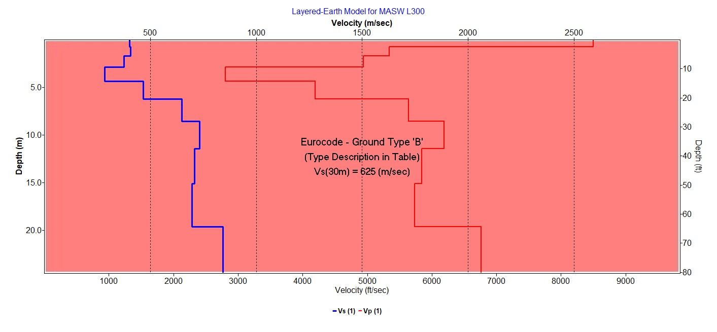
Cont. Application of MASW
Used for seismic site characterisation for Vs30m Evaluation
1-D Shear wave velocity layered model for MASW Line ML300
Source: ParkSEIS v3.0

Slide 16
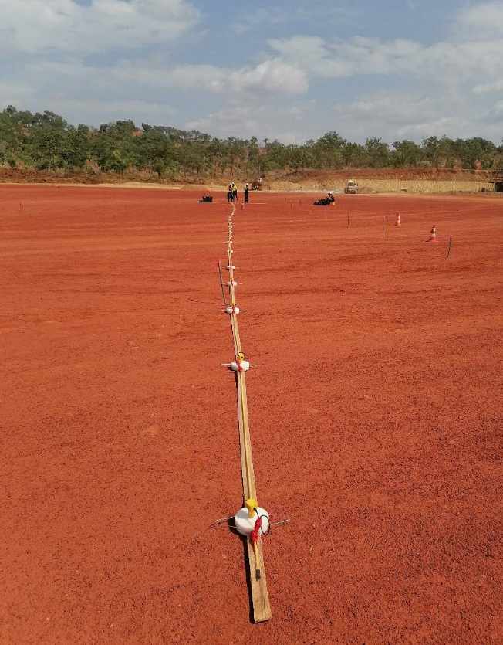
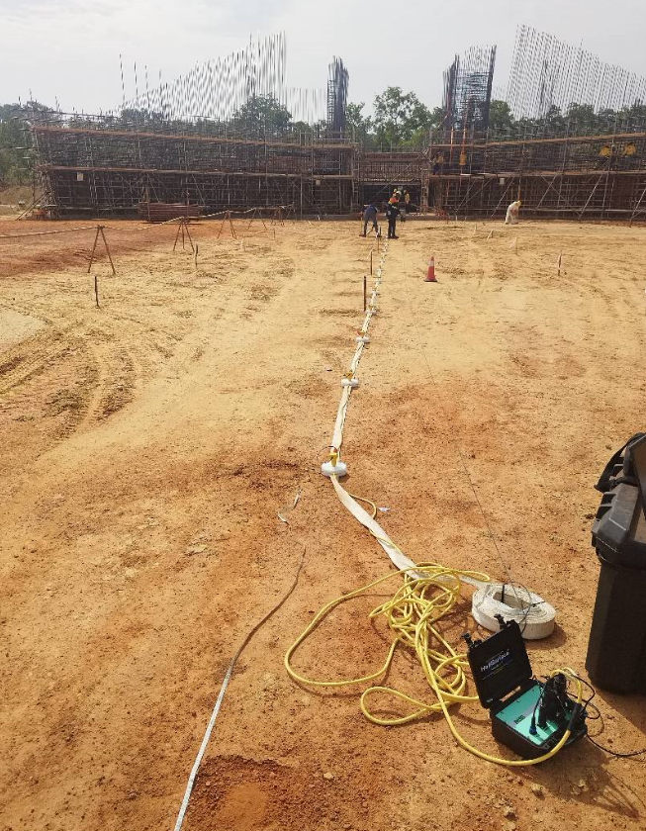
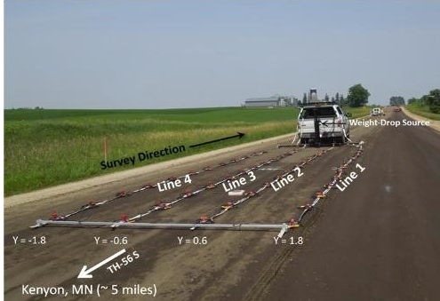
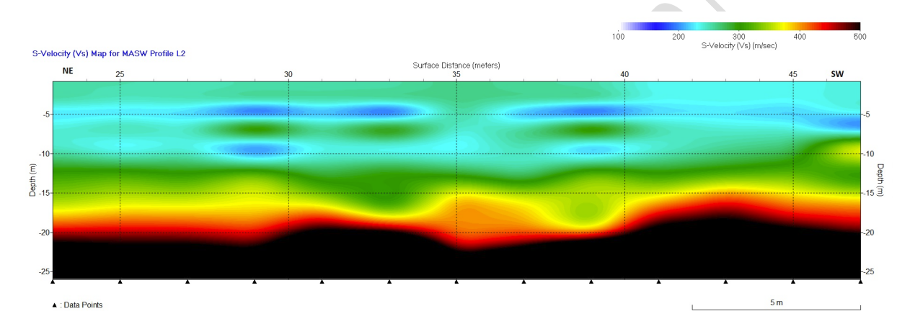
Cont. Application of MASW
Can also be used for compaction evaluation.
Primary & secondary Crusher Area
Source: MASW.com
Surge Bin Area
Notes:
Department of Transport in Minnesota ecently recognised the poytential of MASW surveys in compaction evaluation

Slide 17
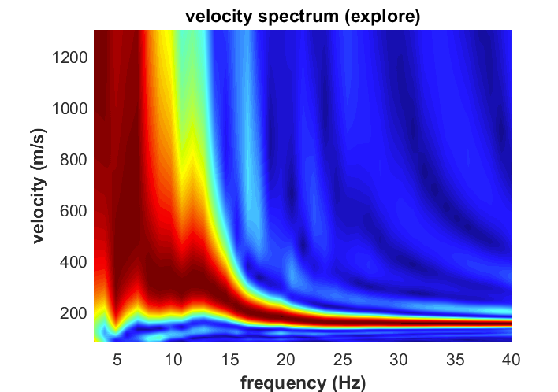
Cont. Application of MASW
Bedrock velocities can easily be depicted in dispersion images from energy patterns created from refracted body waves.
deflection point
Dispersion image for a site at Dzorwulu, Accra.

Slide 18
Cont. Application of MASW
Subgrade reaction calculation
Notes:
density =0.31Vp^0.25

Slide 19
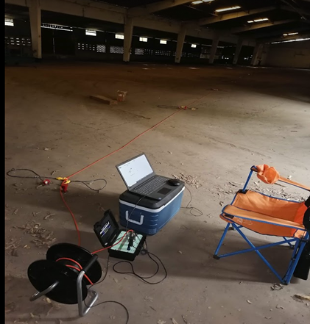
Some Advantages of MASW
MASW is one of the easiest seismic methods that provides reliable results.
In comparison to a conventional drilling, it is fully implemented on the ground surface (non-invasive), covers the subsurface in a continuous manner and provides more complete coverage.
It is a cost effective, efficient and quick way to assess the subsurface and, also complement available geotechnical information.
MASW overcomes the main limitations of traditional geotechnical techniques that can only give limited and localized information with the lack of lateral characterisation of the subsurface.
Equipment and accessories are light and can easily be deployed to hard to reach areas compared a drill rig.
Pioneer Food Canery (Former Aluworks) Tema.

Slide 20
Comparison of Conventional Drilling Method and the MASW Method
Source: MASW.com

Slide 21
Local Examples
2-D Shear wave velocity section for MASW line L300, Ridge, Accra.
Seismic refraction velocity tomogram with Smooth Inversion, 20WET iterations, wavepath width 3.5%. RMS error is 3.6%, initial model for RL100.
Notes:
Wavepath Eikonal Traveltime (WET) Tomography

Slide 22
PASSIVE SEISMIC (HORIZONTAL TO VERTICAL SPECTRAL RATION-HVSR)
The Horizontal-to-Vertical Spectral Ratio (HVSR) is a passive seismic method introduced by Nakamura (1989) measures ambient seismic noise produced by wind and ocean waves.
HVSR exploits the ambient seismic noise signals to estimate properties of unconsolidated, overburden sediments overlying the bedrock.
By measuring three components (UD-NS-EW) of seismic noise over time, HVSR can be used to determine the fundamental resonance frequency (f₀) of the overburden material at a point location.
Therefore, site response analysis using H/V spectral ratios on ambient vibrations is a fundamental part required to evaluate local site effects and assessing seismic hazard in earthquake prone areas.
f₀ is related to layer thickness (h), which is the depth to bedrock and the average shear wave velocity (V_{s}) of the corresponding unconsolidated material.
Notes:
A significant part of damage observed in destructive earthquakes around the world is
associated with seismic wave amplification due to local site effects.

Slide 23
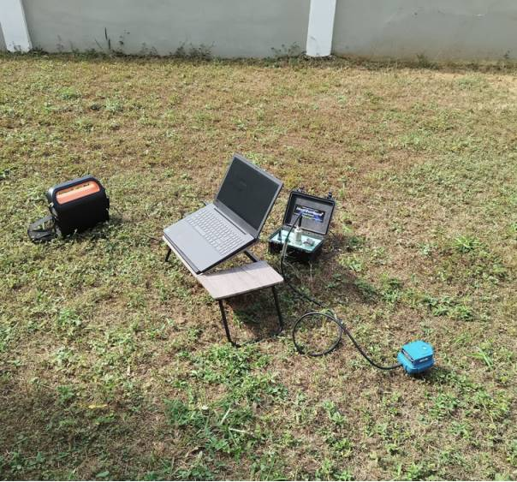
Set-up for HVSR acquisition
Holi 3C geophone which has three components: North-South (NS), East-West (EW) & Vertical (UD)
Passive Seismic data aquisition, Roman Ridge, Accra.

Slide 24
Application
The application of HVSR using passive seismic acquisition method is to determine site response parameters such as:
Determine the impedance contrast between soft and stiff materials.
The resonance frequency, natural peak period, site amplification factor (H/V), and vulnerability index (K_{g}) for the site.
HVSR can also be used to determine the dynamic characterisatics of structures through its modal frequencies (resonance frequencies, eigen-frequencies, natural frequencies...)
Can be used for the vibration analysis.
Provide an estimate of the layer thickness of sediment or shear wave velocity V_{s} (if there is additional information on subsurface geological conditions from geotechnical borings).

Slide 25
HVSR Spectra Curve showing Peak Frequency
HVSR spectra curves for Site H/V1, Roman Ridge, Accra.
Notes:
SESAME: Site EffectS assessment using AMbient Excitations

Slide 26
Conclusion
The use of MASW & HVSR methods in geotechnical site investigations are efficient means of acquiring subsurface information to supplement available geotechnical boring data.
Data acqusition is non-invasive and quick to gather.
Less labour intensive and only 1-2 persons needed for the field work.
The methods are a fast means of providing information for a site.
Cheap compared with having to driil series of boreholes to provide information in a continuous profile.
In-situ measurements of shear wave velocity, Vs can be used to estimate the load-settlement behaviour of shallow and deep foundations.
Vs is used to estimate the small-strain Young’s and Shear moduli of the underlying strata, Poisson’s ration, SPT-N values etc. of these strata.

Slide 27
THANK YOU!
Contact: 0543701222/0207854667
email:info@hglconsultgh.com

