Slide 1
IMPROVING STANDARD OF GEOTECHNICAL INVESTIGATION FIELD TESTING IN GHANA
CASE OF INAPPROPRIATE USE OF DCP TEST EQUIPMENT FOR GEOTECHNICAL INVESTIGATIONS FOR DESIGN OF FOUNDATIONS OF LARGE STRUCTURES

Slide 2
OBJECTIVES OF GEOTECHNICAL SITE INVESTIGATIONS
Assess Suitability of site (soil profile, soil material properties, ground strength trends, settlement potential, geohazards, groundwater)
Obtain Design inputs (soil bearing capacity, geotechnical parameters)
Anticipate Potential Construction challenges
Estimate Seismic response characteristics ( critical for high-rise structures)
liquefaction potential, ground frequencies, etc

Slide 3
GEOTECHNICAL SITE INVESTIGATION-CONDITIONS THAT MUST BE MET
The Reference Standards for both Field Investigation and Laboratory testing must be clearly stated as part of the methodology.
Investigation must cover full depth of foundation influence zone (except in bedrock).
Test equipment must deliver sufficient energy to penetrate full depth of foundation influence zone.
Results must be representative of the whole area of interest.
Field measurements must be corrected to account for energy losses (hammer efficiency, rod length, overburden pressure, etc). Most important factor is the Hammer Efficiency!!

Slide 4
DEPTH OF INVESTIGATION
Critical for settlement analysis
Influenced by:
Magnitude of applied load
Depth of influence of imposed load below depth at which the load is applied
Geometry of the plan area of stressed area

Slide 5
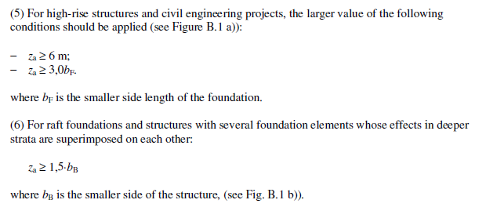
DEPTH OF INVESTIGATION-Eurocode 7 Appendix B

Slide 6
DEPTH OF INVESTIGATION-Eurocode 7 Appendix B

Slide 7
TYPICAL FIELD INVESTIGATION APPROACHES
GEOTECHNICAL
borehole drilling, SPT, & sampling )
Pit excavation, PLT, sampling
Dynamic probing, window sampling
CPT
GEOPHYSICAL
Seismic (refraction/reflection), MASW, HVSR
ERT
A combination of the 2 approaches tends to provide more comprehensive and representative data.

Slide 8
STANDARD PENETRATION TEST (SPT); BS EN ISO 22476 PART 3: 2005
THE MOST UNIVERSALLY ACCEPTED GEOTECH FIELD TEST PROCEDURE FOR ASSESSING GROUND STRENGTH CONDITIONS FOR STRUCTURAL FOUNDATIONS ESPECIALLY IN GRANULAR MATERIAL WITH SIGNIFICANT CONTENT OF SANDS AND GRAVELS (ie “STANDARD PRACTICE”).
HIGH HAMMER DRIVING ENERGY (238 kJ/m2) ENABLES DEEP PERCUSSIVE PENETRATION INTO MOST TYPES OF SOIL FORMATIONS TYPICALLY ENCOUNTERED WITHIN SHALLOW FOUNDATION INFLUENCE DEPTH ZONE (1m to 15m).
ANCILLARY TOOLS ENABLE PASSAGE THROUGH VERY HARD/DENSE FORMATIONS
LOTS OF GEOTECHNICAL CORRELATIONS BASED ON SPT-N₆₀
CONCEPT OF PENETRATION TEST “REFUSAL” BASED ON SPT HAMMER ENERGY NOT BEING ABLE TO CAUSE ADDITIONAL MEASURABLE PENETRATION. (ACCURATE INDICATION OF HIGH BEARING STRENGTH)

Slide 9
DYNAMIC PROBING FOR FOUNDATION INVESTIGATION BS EN ISO 22476-2: 2005
Geotechnical investigation and testing-Field testing- Part 2: Dynamic probing
Describes 4 procedures differentiated primarily by hammer weights (DPL, DPM, DPH, DPSH).
The basis for the selection of which type is to be used should be that the driving energy (hammer mass and height of fall) is appropriate for the ground conditions anticipated.
Results may be used in combination with in-situ sampling (window sampler) for qualitative determination of soil profile.
Results may be used for determination of strength and deformation properties of soils through appropriate correlations.
Geotechnical and equipment related factors can influence the operation of equipment and results of the test.

Slide 10
DIMENSIONS FOR 4 TYPES OF DYNAMIC PROBING APPARATUS (ref; BS EN ISO 22476-2: 2005)
Dynamic Probing Apparatus | Units | DPL | DPM | DPH | DPSH-B
Hammer mass | kg | 10 ± 0.1 | 30 ±0.3 | 50 ±0.5 | 63.5 ±0.5
Height of fall | mm | 500 ± 10 | 500 ± 100 | 500 ± 10 | 750 ± 20
Anvil & guide rod mass | kg | 6 | 18 | 18 | 30
Cone angle Cone base area (A) Cone base dia (min) | deg cm² mm | 90 10 35.7 | 90 15 43.7 | 90 16 43.7 | 90 20 450.5
Drive rod mass Drive rod dia | Kg/m mm | 3 22 | 6 32 | 6 32 | 8 35
Specific work/blow E_{n}=mgh/A =E_{theo}/A | kJ/m² | 50 | 100 | 167 | 238

Slide 11
EVALUATION OF DYNAMIC PROBING RESULTS
Because of hammer fall energy losses, it is recommended to know by calibration, the actual energy transmitted to the drive rods (Etheo) when this test is used for quantitative evaluation purposes.
Consideration shall be given to the influence of rod friction by side adhesion and rod bending on the recorded test values.
The dynamic point resistance (qd)may be determined for quantitative interpretation of the results.

Slide 12
BASIC DESCRIPTION OF DCP
DROP WEIGHT: 8KG
ANVIL & GUIDE ROD WEIGHT: 6KG
DROP HEIGHT: 575MM MAX ENERGY: 46 J
ROD DIA: 20MM
CONE ANGLE: 60 DEG
EFFECTIVE INVESTIGATION DEPTH: 800MM
MAX INVESTIGATION DEPTH: 1500MM
PRIMARY USE: ASSESSMENT OF IN-SITU STRENGTH OF FLEXIBLE PAVEMENTS MADE OF UNBOUND MATERIALS

Slide 13
DCP-DPL COMPARISON
DPL cone area = 2 x DCP cone area
DCP side friction >>> DPL ➔ greater energy losses
Device | Hammer mass (kg) | Drop ht (mm) | Cone area (cm2) | Cone dia (mm) | Rod dia (mm) | Specific work/blow (kJ/m2)
DCP | 8 | 575 | 5 | 20 | 16 | 92
DPL | 10 | 500 | 10 | 35.7 | 22 | 50

Slide 14
LIMITATIONS OF DCP (Annex D)
The low driving energy (theoretical maximum of 92kJ/m2), is not able to penetrate dense soil strata including formations containing pockets of sandy gravel or decomposed rocks even at shallow depth ➔ inability to detect underlying weak zones.
There are significant energy losses to side friction due to extremely small clearance around drive rods. Increasing blow count after 1m depth will not be directly attributable to increasing formation density.

Slide 15
LIMITATIONS OF DCP
Cumulative energy losses from inertia (total probe weight), hammer efficiency, and side friction, restrict DCP from effectively testing the full depth of the influence zone for a typical pad footing (eg. w=1.2m) placed at a shallow depth of 1.0m (d_{i}= 4m).
Limited penetration depth prevents detection of underlying weak zones typically between 2m to 4m depth.
The overall effect is that the DCP test is not able to accurately generate information about the ground strength conditions of soil formations below 2m penetration depth.

Slide 16
Observations from DCP reports
2-3pts and 1 test pit typically used for investigations for buildings from 3-storeys to 6-storeys.
Typical probing depths mainly between 0.5 and 1.5m.
Typical pit depths between 1 and 1.2m.
Typically high bearing capacities assigned to shallow depths (0.5-1.2m) mainly in gravelly sand/sandy clay.
Photographs always of DCP but details of equipment dimensions mainly a mix of DCP & DPL dimensions.
Bearing Capacity calculations based 2 formulae
Qult=30r or Qall=30r

Slide 17
Issue 1: BC FORMULA: Qall=30r
Dutch formula: $R_{D}=\frac{m^{2}H}{Ae\left(m+P\right)}$ [daN/cm2] or bar
m(kg), P(kg), H(cm), A(cm2), e(10cm/blow)
Commonly quoted derivation
$R_{D}=\frac{m^{2}H}{Ae\left(m+P\right)}$ = $\frac{6250}{e}$ = $\frac{6250}{\frac{10}{r}}$=$625r$
Valid if (A= .0005m², m=10kg, H=0.5m, , m+P=16 kg,)
Problem!!! Units not consistent with reference formula.
mDPL=10kg, HDPL=0.5m, ADCP=0.0005m²
${BC}_{all}=\frac{R_{D}}{20 }$= $\frac{625r}{20}$ =$31.3r$➔30r(kPa) ???

Slide 18
Issue 2: CUMMULATIVE EFFECT OF ROD WEIGHTS
Depth (m) | Rod wt (kg) | M+P (kg) | R_{D} | BC_{all}
1 | 3 | 16 | 625r | 30r
2 | 6 | 19 | 526r | 26r
3 | 9 | 21 | 476r | 24r

Slide 19
Allowable BC: Qa=30r ISSUES THAT CONTRIBUTE ERRORS
The simplified formula does not address the issue of the units for drop height and cone area clearly.
Although the DCP device is used for field testing the calculations are typically based on DPL dimensions (some input figures do not reflect actual equipment used).
The weight effects of additional rods are not factored into computation as probing depth increases.
Field measurements are not corrected for energy transfer losses and friction losses. Typical energy transfer ratios range between 0.4 and 0.6, mainly dependent on hammer release mechanism and consistency of blows/min. DCP release is manual.
The overall effect is a gross over-estimation of the soil resistance.

Slide 20
TEST RESULTS INTERPRETATION USING DYNAMIC RESISTANCE (REF: BS EN ISO 22476-2:2005- ANNEX E)
Unit resistance $q_{d}=\frac{E_{meas} }{Ae}=\frac{mgh}{Ae},$ [Pa]
Dynamic resistance${ R}_{d}=\left(\frac{m}{m+m_{a}+m_{r}}\right)×q_{d}$
$R_{d}= \left(\frac{1}{m+m_{a}+m_{r}}\right)\frac{m^{2}gh}{Ae}$ [Pa] --- Dutch formula
Allowable soil pressure $p_{a}=\frac{R_{d}}{20}$ (FS = 4) (Sanglaret)
m (kg)=Mass of Hammer | $m_{a}$(kg) =Mass of anvil & guide rod | $m_{r}$(kg) =Total mass of rods
g (m/$s^{2}$)=Accn due to gravity | h (m)=Height of hammer fall | A ($m^{2}$) = Cone base area
e(blows/m) penetration rate

Slide 21
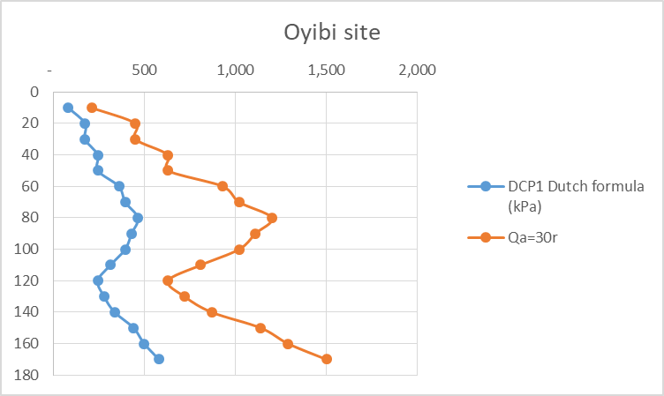
SAMPLE DATA: Dutch Formula vrs Qa=30r (kPa)
Depth (m) | N-10 | Dutch (kPa) | Qa=30r (kPa)
10 | 7 | 90 | 210
20 | 15 | 193 | 450
30 | 15 | 193 | 450
40 | 21 | 271 | 630
50 | 21 | 271 | 630
60 | 31 | 400 | 930
70 | 34 | 438 | 1020
80 | 40 | 516 | 1200
90 | 37 | 477 | 1110
100 | 34 | 438 | 1020
110 | 27 | 348 | 810
120 | 21 | 271 | 630
130 | 24 | 309 | 720
140 | 29 | 374 | 870
150 | 38 | 490 | 1140
160 | 43 | 554 | 1290
170 | 50 | 644 | 1500

Slide 22
IMPLICATIONS OF ERRONEOUS FIELD RESULTS
Over-estimation of bearing strength of resistant soil layers.
Masking of presence of weak zones beneath more resistant upper strata.
Termination of investigation without penetrating depth of foundation influence zone.
Erroneous basis for applying geotechnical correlations.

Slide 23
DPSH EXAMPLE 1- BANDA (B/A)

Slide 24
DPSH EXAMPLE 2- KUMASI

Slide 25
DPSH EXAMPLE 3-TEMA C1

Slide 26
DPSH EXAMPLE 4-NORTH DZORWULU

Slide 27
CONCLUSIONS
Results from the lightweight (8kg) DCP test apparatus are typically exaggerated at depth because of high energy losses that diminish the impact energy of hammer system. Results from below 2m depth are significantly affected and therefore are not representative of the true state of affairs.
Continued deployment of DCP equipment as a primary tool for geotechnical field investigations is undermining efforts to attract investments in standard geotech investigation equipment to improve indigenous capacity for proper investigations.
The use of the DCP test equipment as the primary field testing device for foundation geotechnical investigations should be discouraged.

Slide 28
WAY FORWARD
The GhIE should collaborate with Eng Council (& Ghana Standards Authority) to ensure the ff:
Prohibit the use of the DCP test equipment for geotechnical site investigations for buildings that require building permit approval.
Register every ground investigation test rig and conduct of energy calibration tests to determine hammer energy efficiency factor specific to each rig.
Register and certify all laboratories offering engineering soil testing and construction quality control services in support of geotechnical investigations.

Slide 29
WAY FORWARD
GhIE should develop standard guidelines for timely review of geotech investigation reports that also ensure the traceability of the field equipment, and the testing laboratory.
All Engineers who sign geotechnical investigation reports should be required to have professional indemnity insurance cover.
Engineers who are staff of the MMDA development (building) permit approval system (District Planning Authority) should be prohibited from engaging in provision of geotechnical investigation services in any MMDA jurisdiction (Conflict of Interest situation).

Slide 30
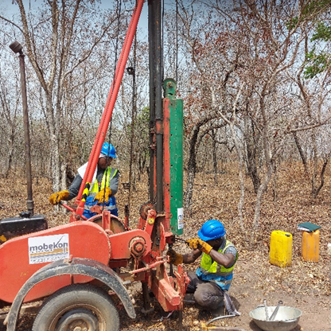
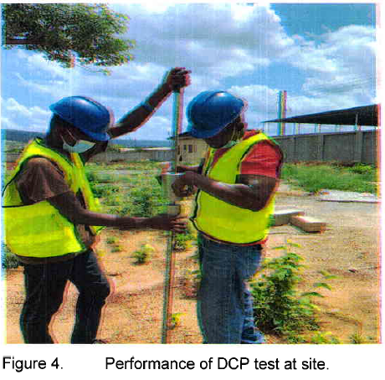
DPSH RIG DCP EQUIP

Slide 31
THE END

